Slide 1
Unit 5: Reproduction
Unit review

Slide 2
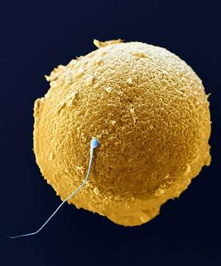
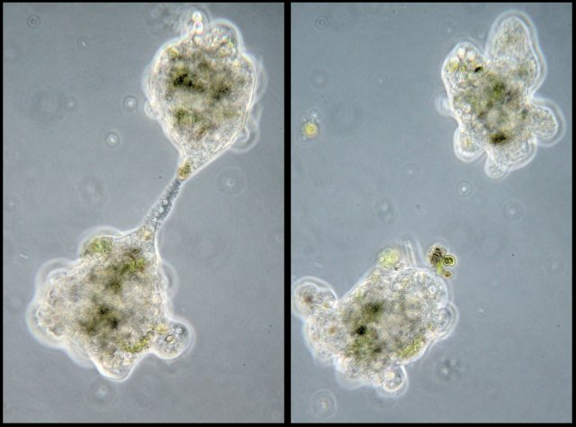
Topic 1: Introduction to the Cell Cycle
Sexual reproduction vs. Asexual reproduction
Examples
Advantages vs. disadvantages
Variation

Slide 3
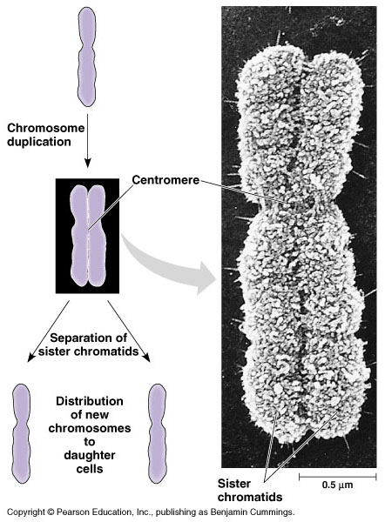
Topic 1: Introduction to the Cell Cycle
DNA organization
Chromatin
Chromosome
Replicated vs. unreplicated
Homologous pairs
Sister chromatids

Slide 4
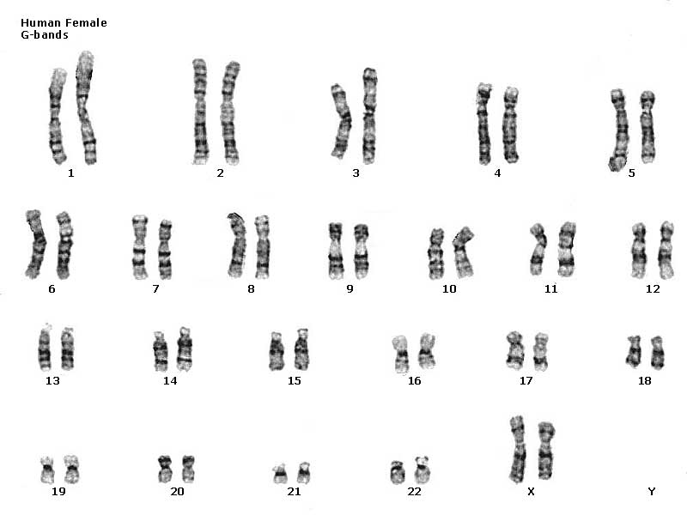
Topic 1: Introduction to the Cell Cycle
Karyotype
Autosomes vs. sex chromosomes

Slide 5
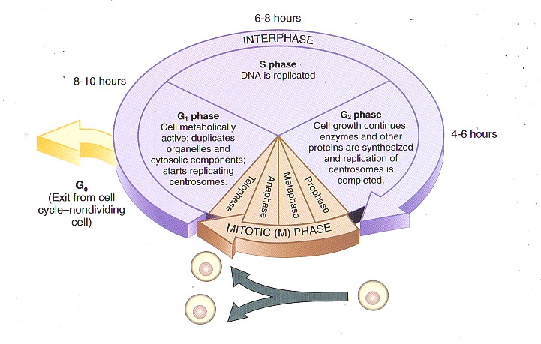
Topic 1: Introduction to the Cell Cycle
Cell Cycle
Interphase
G₁
S
G₂
Mitosis (M)
G₀

Slide 6
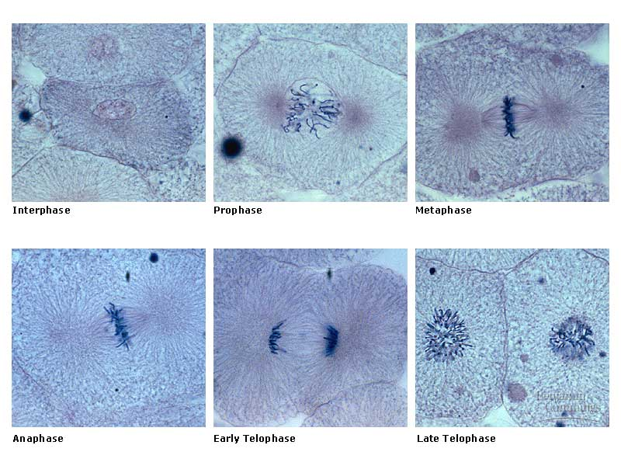
Topic 1: Introduction to the Cell Cycle
Mitosis
For each phase
Nucleus?
Spindle formed?
Chromosomes?
Cytokinesis
Plant vs. animal

Slide 7
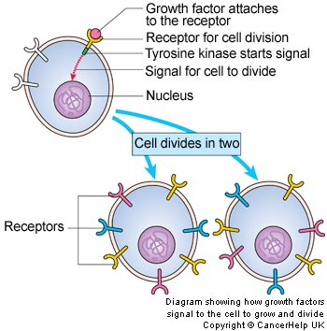
Topic 2: Regulation of the Cell Cycle
Growth factors
Density dependent division
Anchorage

Slide 8
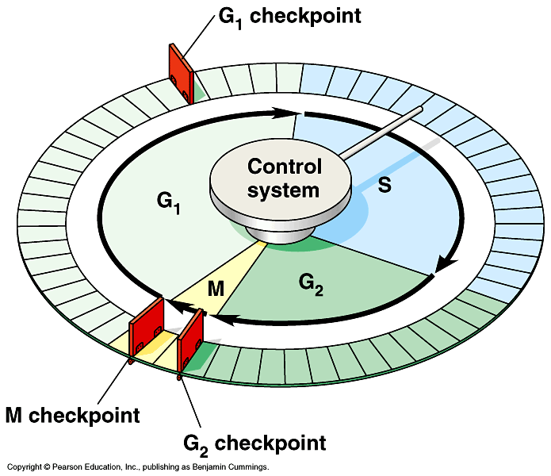
Topic 2: Regulation of the Cell Cycle
Cell cycle check points
Middle of G₁
End of G₂
Metaphase

Slide 9
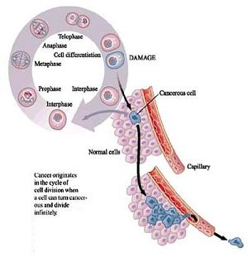
Topic 2: Regulation of the Cell Cycle
Cancer
Uncontrolled cell division
Relationship to the cell cycle
Causes
Tumors
Benign vs. Malignant
Metastasize

Slide 10
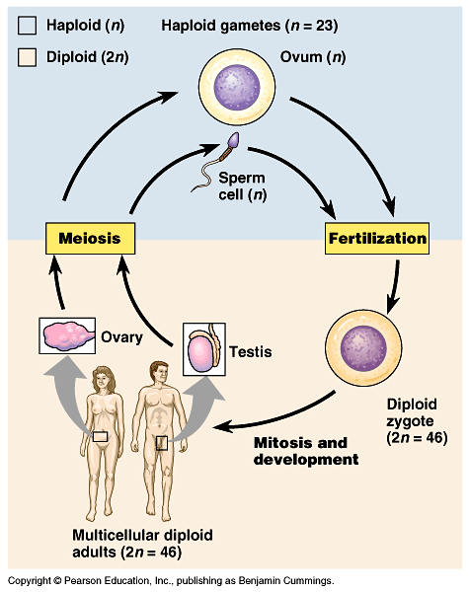
Topic 3: Meiosis
Somatic vs. gamete
Haploid vs. diploid
Fertilization
zygote

Slide 11
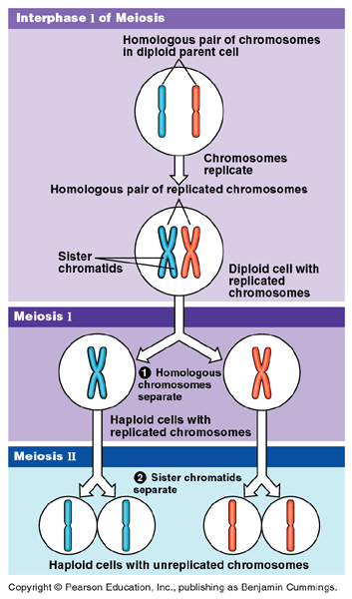
Topic 3: Meiosis
Meiosis
For each phase
Nucleus?
Spindle formed?
Chromosomes?
Comparisons to Mitosis

Slide 12
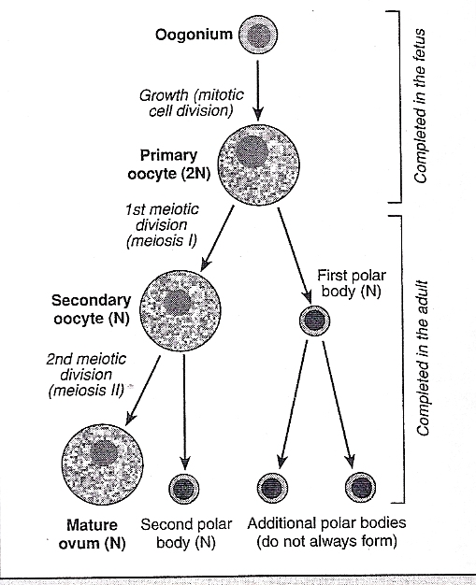
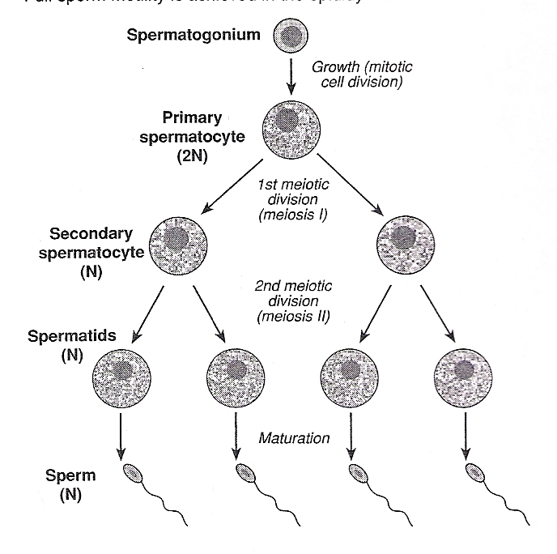
Topic 3: Meiosis
Oogenesis vs. Spermatogenesis

Slide 13
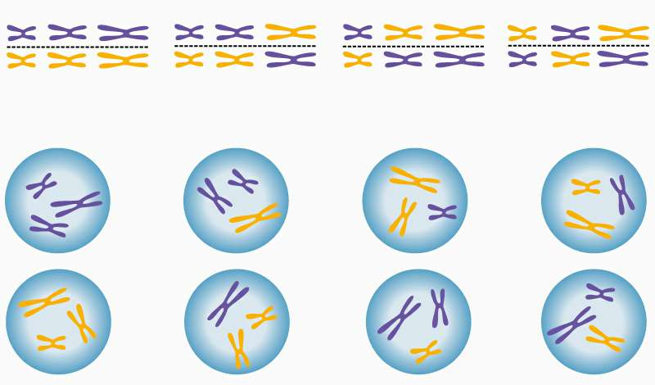
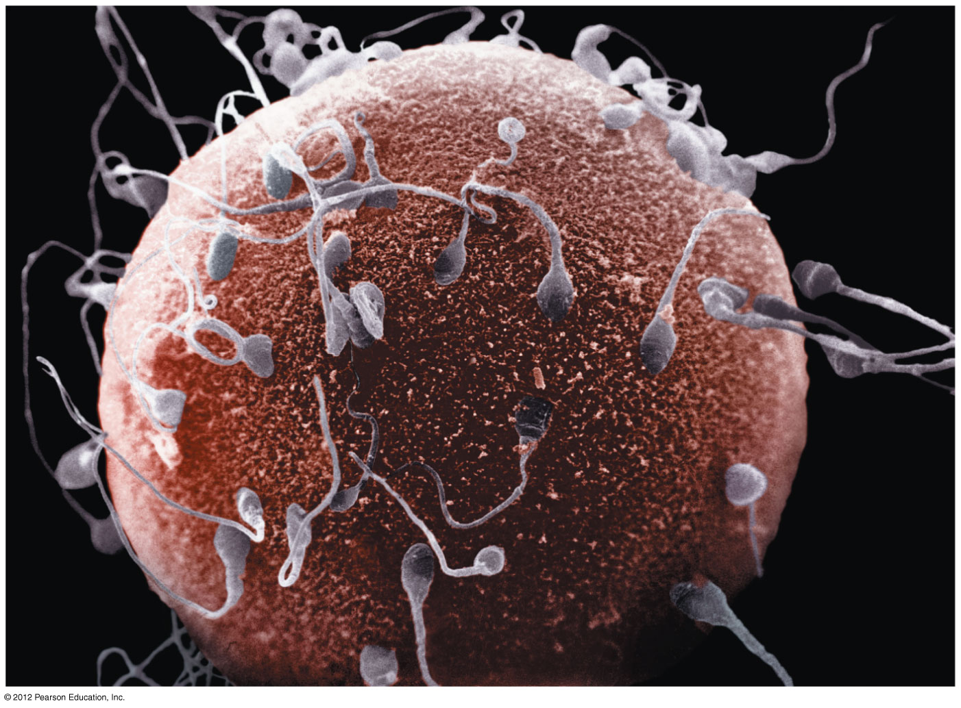
Topic 3: Meiosis
Genetic Variation
Independent assortment
Crossing over
Random fertilization

Slide 14
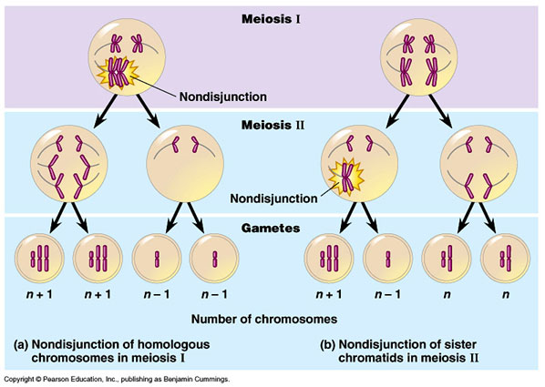
Topic 3: Meiosis
Nondisjunction
Monosomy
Trisomy

Slide 15
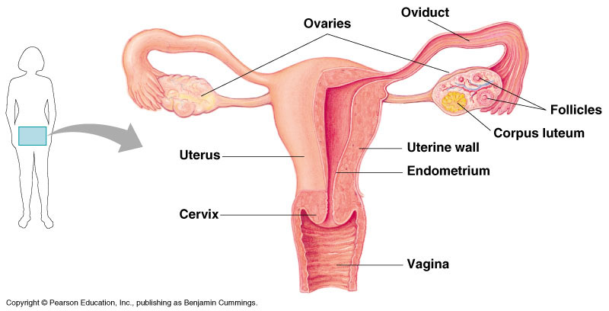
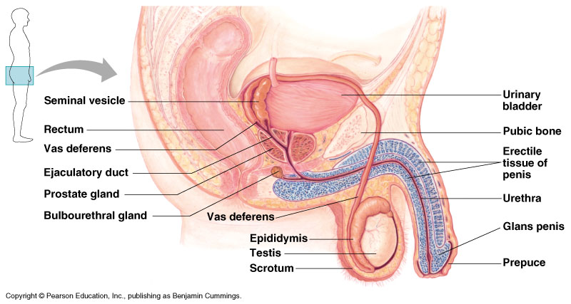
Topic 4: Human Reproduction
Trace the path of the gametes
Male Anatomy
Female Anatomy

Slide 16
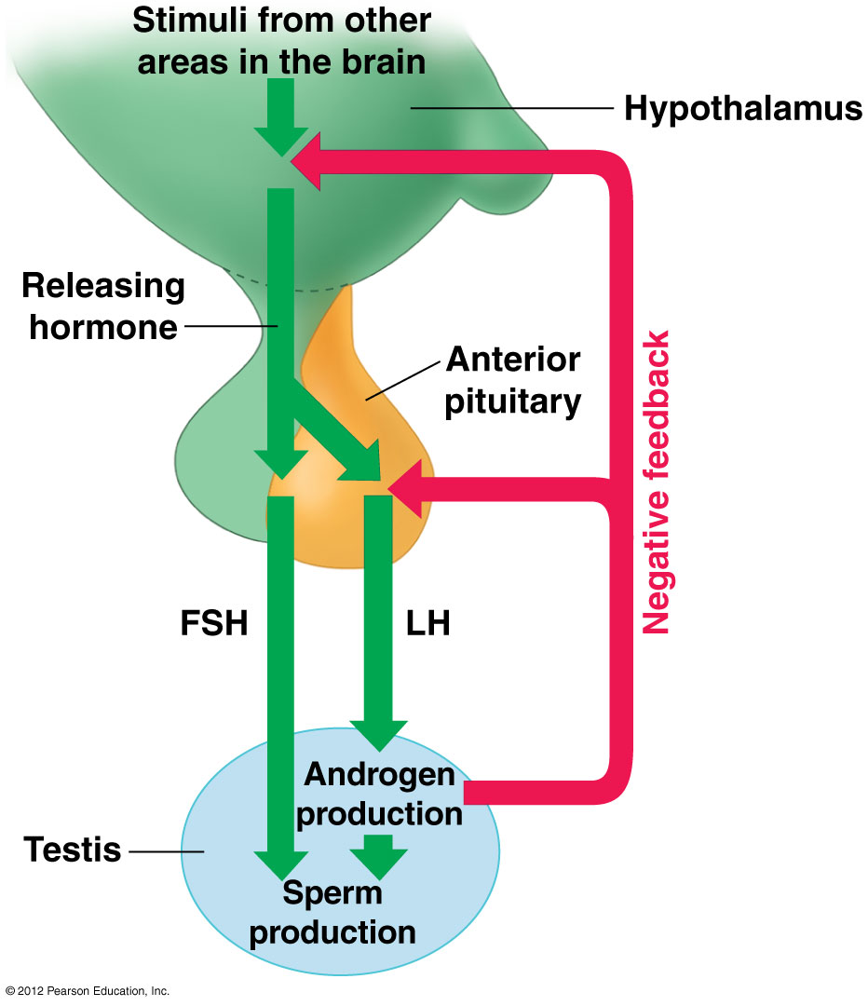
Topic 4: Human Reproduction
Hormones related to sperm production
GnRH
FSH
LH
Testosterone

Slide 17
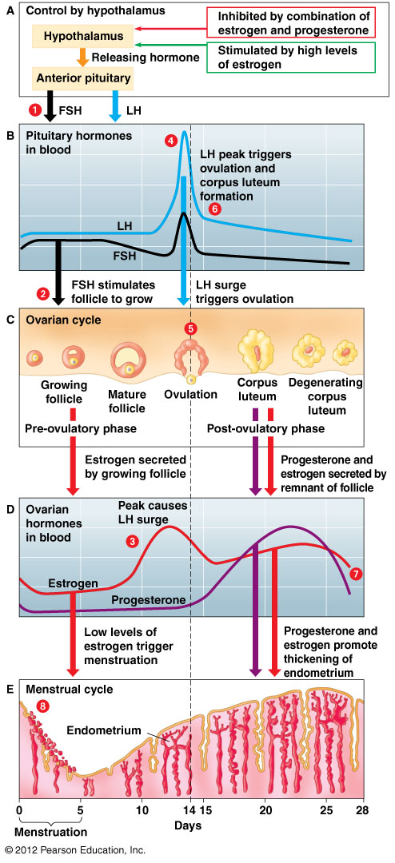
Topic 4: Human Reproduction
Hormones that regulate the female reproductive cycle
Ovarian cycle
GnRH
FSH
LH
Menstrual Cycle
Estrogen
Progesterone

Slide 18
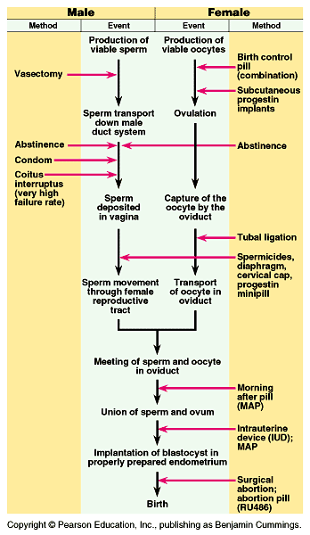
Topic 4: Human Reproduction
Contraception
Biological Basis
Examples of
Physical barriers
Behavioral
chemical

Slide 19
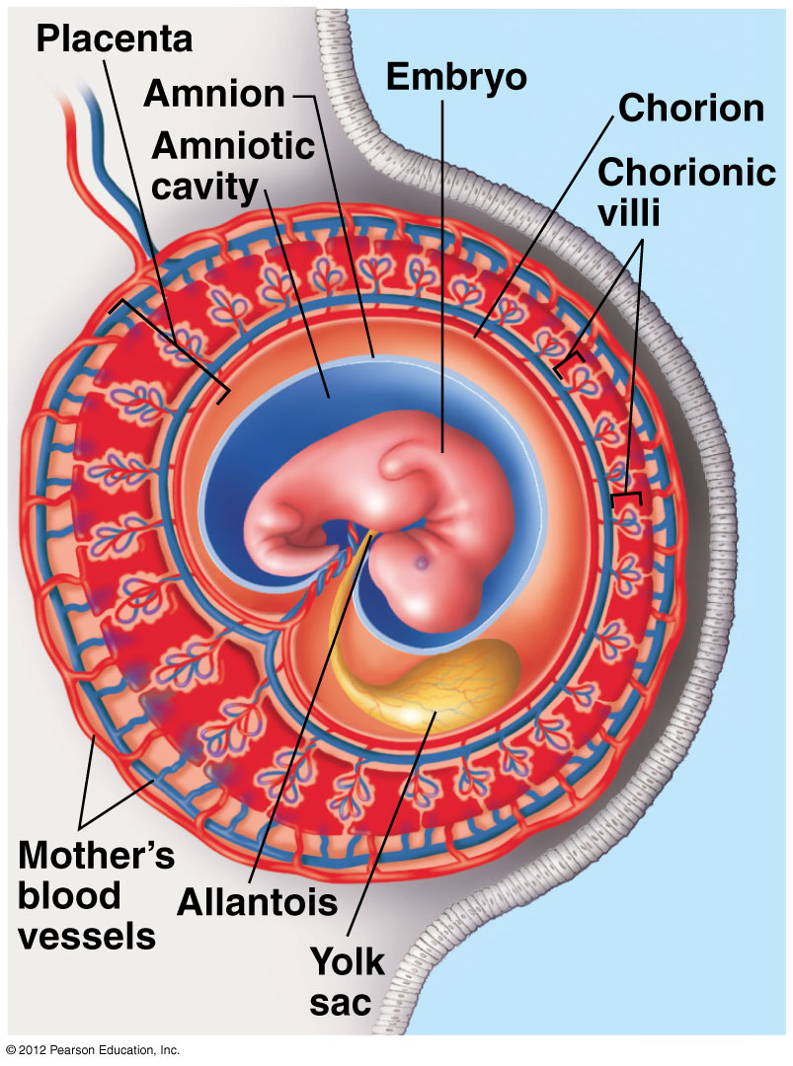
Topic 4: Human Reproduction
Fertilization
Early Development
Blastula
Gastrula
Implantation
hCG hormone
Pregnancy
Roll of the placenta
Trimester highlights

Slide 20
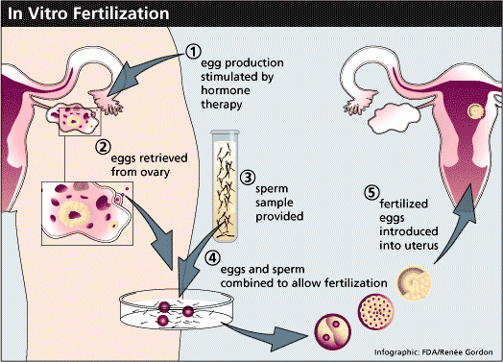
Topic 4: Human Reproduction
Reproductive technology
IVF

Slide 21
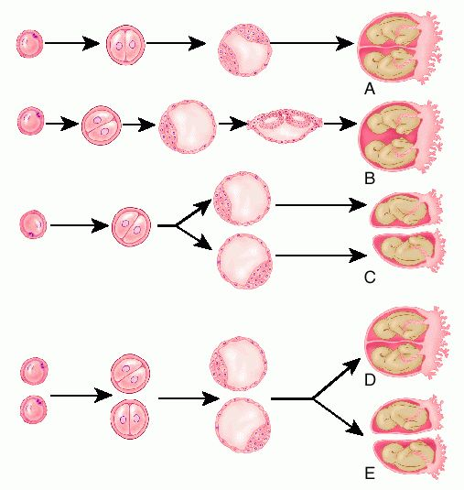
Topic 4: Human Reproduction
Twins
Monozygotic
Dizygotic

Slide 22
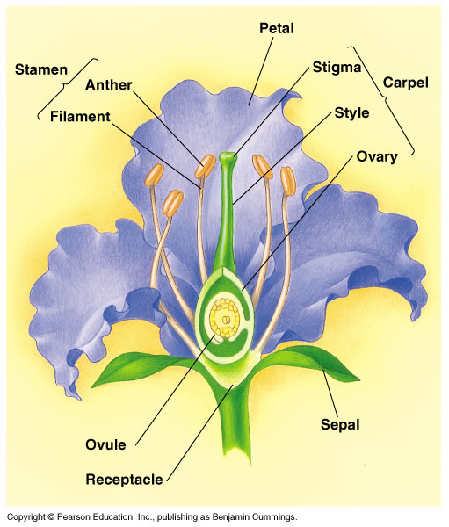
Topic 5: Seed Plant Reproduction
Flower anatomy

Slide 23
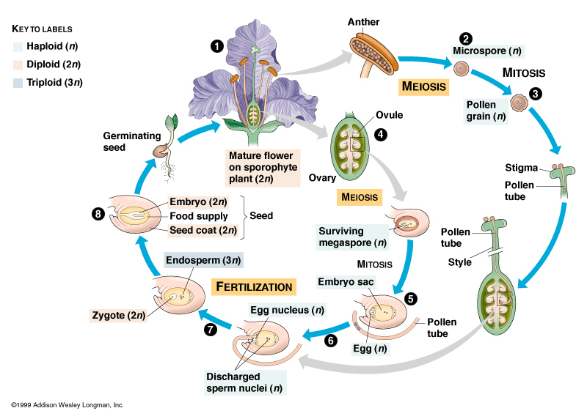
Topic 5: Seed Plant Reproduction
Life cycle
Meiosis
Pollination
Double Fertilization
Seeds vs. fruits
Germination

