Slide 1
Unit 5: Gene Action
Quest Review

Slide 2
Journal 5-2: History of DNA
Observation vs. Inference
Experiment | Question? | Observation | Conclusions
Frederick Griffith (R, S bacteria effects on mice) | What causes virulence in bacteria? | R strain bacteria transform into living S bacteria in the presence of dead S bacteria | Virulence was transferred from S to R bacteria
Oswald Avery (Griffith’s exp. with enzymes) | What is being transferred from S to R bacteria? | Dead S bacteria do not transfer virulence when DNA is digested with an enzyme | DNA is the molecule for information transfer (molecule of inheritance), not protein
Hershey and Chase (bacteriophages) | What type of molecule is injected into bacteria (DNA or protein) | Radioactive DNA found inside of bacteria, radioactive protein found outside of bacteria | DNA is the molecule for information transfer (molecule of inheritance), not protein

Slide 3
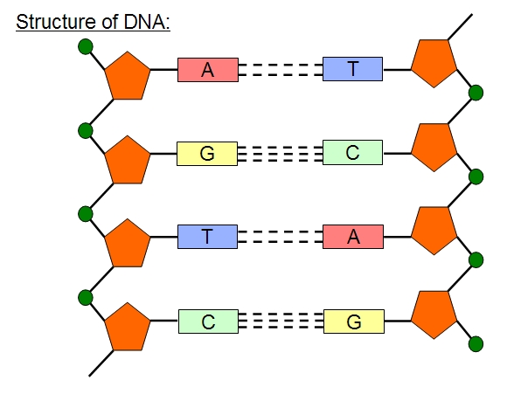
Journal 5-3: Modeling DNA and Replication
sugar
Covalent bond
nucleotide
phosphate
Hydrogen bonds
Nitrogenous base

Slide 4
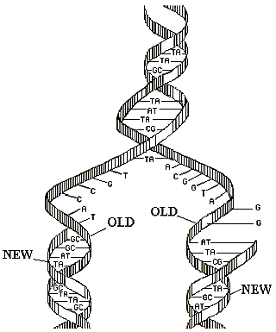
Journal 5-3: Modeling DNA and Replication
DNA Replication
DNA Polymerase
Helicase
Occurs in the nucleus
Occurs before cell division
Base Pairing
A-T
G-C

Slide 5
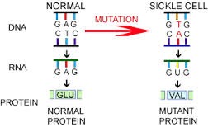
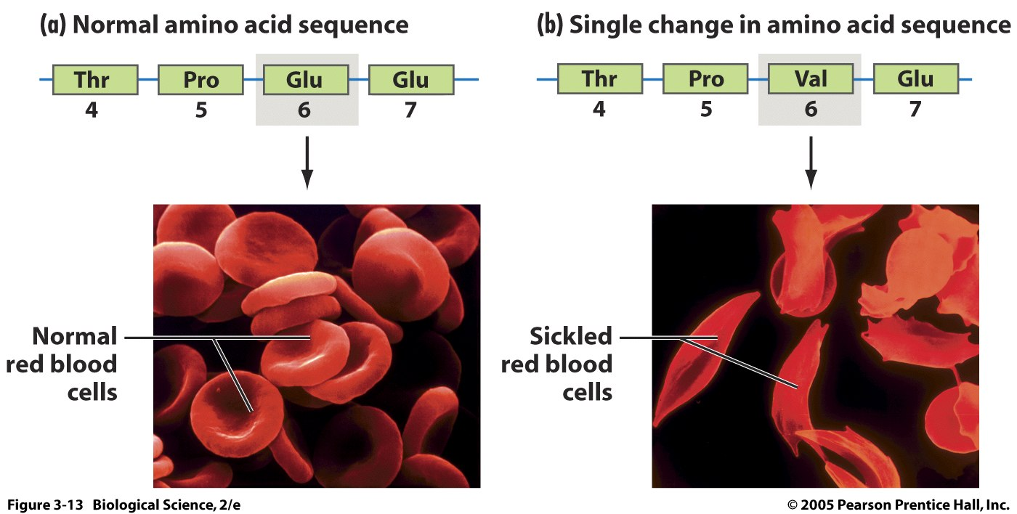
Journal 5-5: Genes, Proteins and Disease
Genotype - Letters in your DNA
Ex. Gene mutation that causes sickle cell
Phenotype - physical trait or characteristics
Ex: Symptoms of Sickle Cell

Slide 6
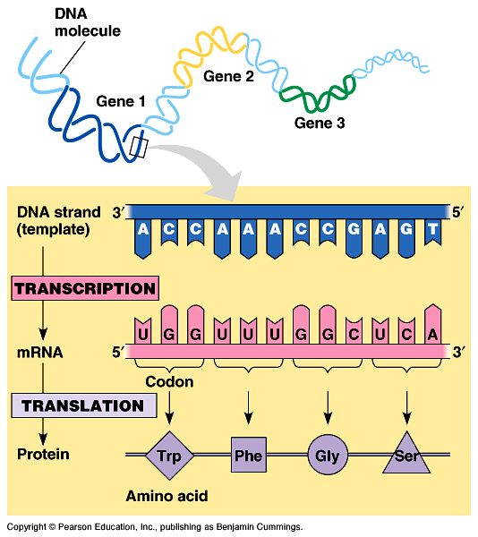
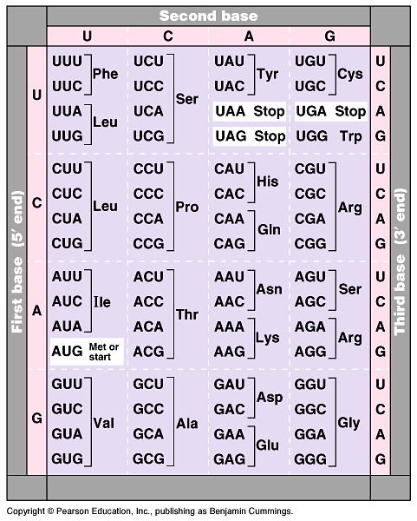
Journal 5-6: A Closer Look at Protein Synthesis
Transcription
DNA to mRNA
Base pairing rules
C-G
A-T(U)
Translation
Codon
Genetic Code

Slide 7
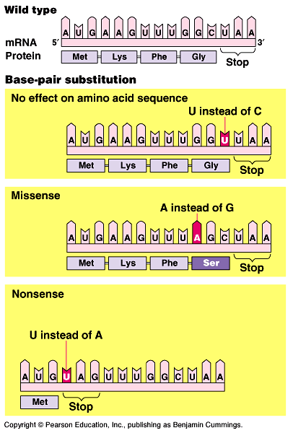
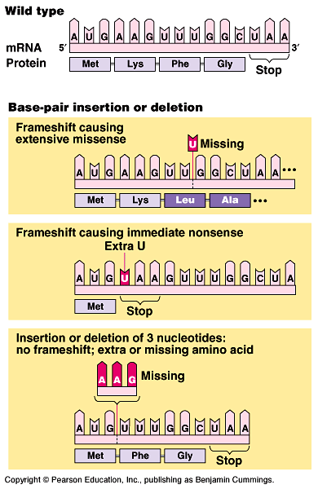
Journal 5-6: A Closer Look at Protein Synthesis
Mutation
Point mutation
Frameshift mutation

Slide 8
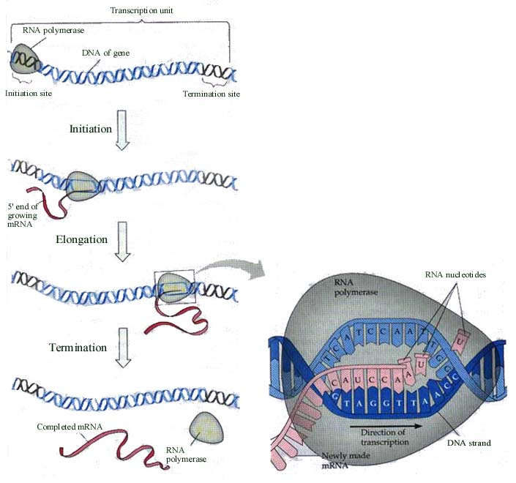
Journal 5-6: A Closer Look at Protein Synthesis
Protein Synthesis (Gene Expression) is a biochemical process
Transcription
Occurs in the nucleus
RNA polymerase

Slide 9
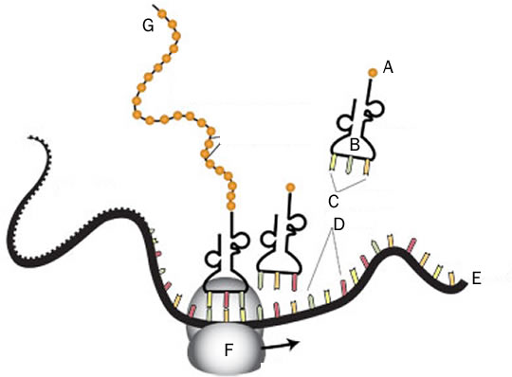
Journal 5-6: A Closer Look at Protein Synthesis
Protein Synthesis (Gene Expression) is a biochemical process
Translation
Occurs in the cytoplasm
Ribosome
tRNA
Codon – anticodon
A – amino acid
B – tRNA
C – anticodon
D – Codon
E – mRNA
F – Ribosome
G – polypeptide (amino acid chain)

