Slide 1
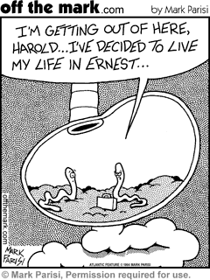
Topic 6
Overview of human digestion

Slide 2
Why eat???? Why digest??
Eating food - ingestion
Obtain energy
Carbohydrates
Triglycerides
Obtain building blocks for our organic molecules
Amino acids
Digesting food - digestion
Ingested molecules are too big!
It needs to be absorbed into your blood stream…
If they are not absorbed…they are eliminated
What you ingest is not necessarily what your body needs…

Slide 3
Why digest food?
Too big
Small enough
Polysaccharides (starch, etc)
Disaccharides (sucrose, etc)
Triglycerides
Proteins and polypeptides
Monosaccharides (glucose, fructose, etc)
Fatty acids
Glycerol
Amino acids
Water

Slide 4
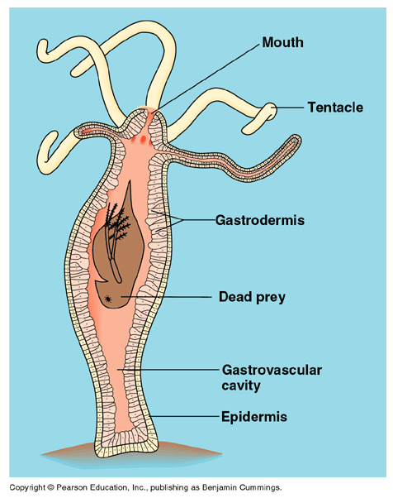
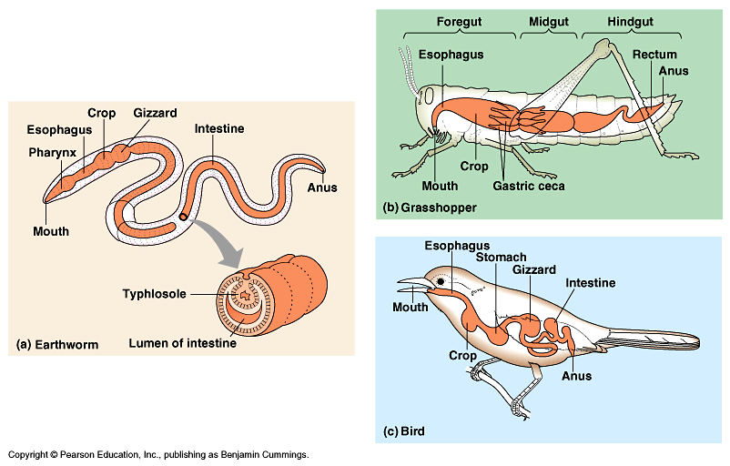
Food processing - Extracellular
OBJ 32
Outside of the cell membranes
Digestion occurs in a digestive tract

Slide 5
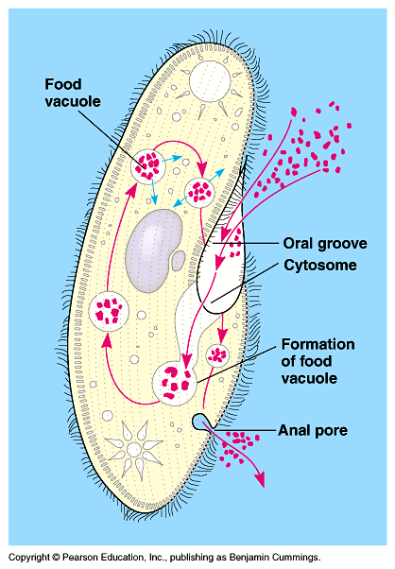
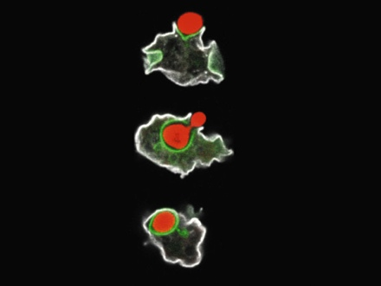
Food processing - Intracellular
OBJ 32
Occurs inside of cell membranes
Single celled organisms do this

Slide 6
Food processing
OBJ 31
Ingestion - Eating
Digestion
Mechanical – Physical breakdown of food
Chewing
Chemical – chemical reactions
Degradation hydrolysis
Enzymes
Absorption
What? Where? How?
Elimination
If it is not absorbed…it is eliminated
What you ingest is not necessarily what your body needs…

Slide 7
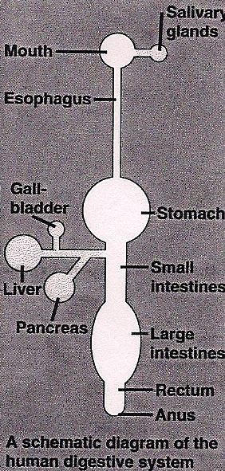
Digestive System Overview
OBJ 30, 33

Slide 8
Mouth
OBJ 33, 34
Teeth
Mechanical digestion
Canines vs. molars
Saliva
Lubricates food
Neutralizes food acids
Antibacterial agents kill bacteria
Salivary amylase – chemical digestion of starch to disaccharides
Tongue
Taste buds
Forms a “bolus”

Slide 9
Pharynx
OBJ 33
Leads to esophagus (digestion) and trachea (respiration)
Epiglottis protects the trachea when the bolus pushes it shut in the process of swallowing

Slide 10
Esophagus
OBJ 33
Muscular tube
Moves bolus through peristalsis (wave-like contractions)
Acid reflux?

Slide 11
Stomach
OBJ 33, 34
Muscular pouch
Storage of consumed food
Chemical digestion
Pepsin enzymes – digest proteins into polypeptides
Mechanical digestion
Churning – mixing of bolus, turns into chyme
Structures
Pyloric Sphincter
Esophageal sphincter

Slide 12
Stomach – regulation of stomach acid and activation of pepsin enzyme
OBJ 36
Hormone controlled cycle – negative feedback loop
Gastrin – hormone that stimulates release of HCl
released when eating
HCl – breaks down food, activates pepsin (pH 1-2)
Pepsinogen – inactive pepsin (which breaks apart proteins into polypeptides)
Mucus – protects wall

Slide 13
Stomach – gastric ulcers

Slide 14
Small Intestine
OBJ 33, 34
More than 6 m long and 2.5 cm in diameter
Pushes food through with peristalsis
Duodenum
1st section (25 cm or so)
Where hydrolysis finishes – Chemical digestion

Slide 15
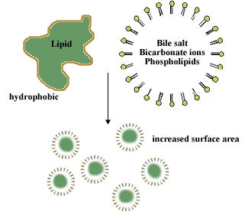
Small Intestine - Duodenum
OBJ 33
What you need in the duodenum
Bile
From liver via gallbladder
Increases lipid surface area by emulsification (Mechanical digestion)

Slide 16
Small Intestine - Duodenum
OBJ 33, 34
What you need in the duodenum
Pancreatic Juice
Bicarbonate neutralizes chyme
Pancreatic amylase hydrolyzes starch
Proteases hydrolyze protein (trypsin)
Nucleases hydrolyze nucleic acids
Lipase hydrolyzes lipids
Chemical Digestion

Slide 17
Small Intestine - Duodenum
OBJ 33,34
What you need in the duodenum
Intestinal Juice
Enzymes that chemically digest disaccharides
Ex. Maltase, sucrase, lactase

Slide 18
Small Intestine - Absorption
OBJ 33
Jejunum (2nd section)
Ileum (3rd section)
Absorption occurs here
Huge surface area (300 m²)
Lots of folds, villi, and microvilli

Slide 19
Small Intestine - Absorption
OBJ 33
What? – Monomers of biochemical molecules
Where? – into the blood stream
How? – Diffusion, Active transport (Big topic in the Cells Unit)

Slide 20
Large Intestine or Colon
OBJ 33
What’s left?
Water
Cellulose (fiber)
Other nondigestible material
About 1.5 m long, 5 cm diameter
Absorbs water
E. coli produce vitamins (vitamin K)
Feces stored in rectum
Appendix – vestigial structure or not?
Rectum – final storage before excretion

Slide 21
Digestive System Overview
OBJ 30, 33

Slide 22
The breakdown…
OBJ 34
Molecules | Where chemically digested
Carbohydrates | Mouth (to disaccharides) Small Intestine (to disaccharides and monosaccharides)
Proteins | Stomach (to polypeptides) Small Intestine (to polypeptides and amino acids)
Lipids | Small Intestine (to smaller lipids, then glycerol and fatty acids)
Nucleic Acids | Small Intestine (to nucleotides)

Slide 23
Where foods are broken down with enzymes
OBJ 34, 35, 37

Slide 24
Structure and Function in Digestion
Mouth
Teeth – canines vs. molars – chewing increases surface area of food
Esophagus
Tough, elastic connective tissue to stretch
Layers of smooth muscle for peristalsis
Stomach
Muscular walls for churning – increases surface area of food
Mucus lining to protect from acid and protease
Small Intestine
Long and folded, with villi for lots of absorption because of its large surface area

