Slide 1
Unit 1: Chemistry of Life
Test Review

Slide 2
Unit Test Format
40-45 Multiple Choice questions
Scantron
1-2 Short answer questions
Multiple sections

Slide 3
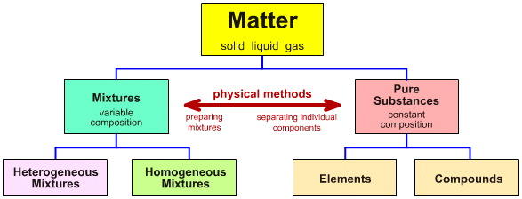
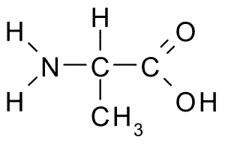
Topic 1: The Nature of Matter
Pure substance vs. Mixture
Solutions
Elements
Atoms
Compounds
Molecules
SPONCH
Ions vs. Isotopes
Molecular vs. structural formula

Slide 4
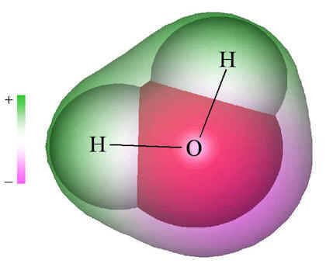
Topic 2: Bonding and Properties of Water
Ionic vs. Covalent Bonding
Polar covalent Bond
Electronegativity
Polar Molecules
Ex. Water

Slide 5
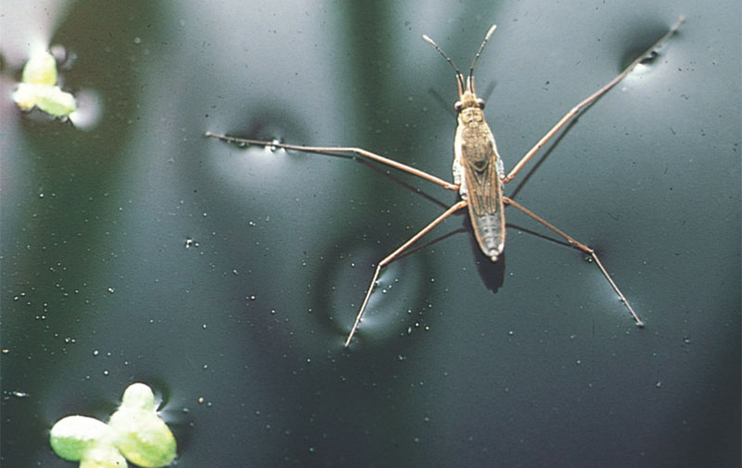
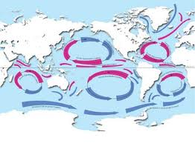
Topic 2: Bonding and Properties of Water
Properties of Water – Biological significance for each
Cohesion
Surface tension
Adhesion
High specific heat
High heat of vaporization
Ice density vs water density
Universal Solvent
solutions

Slide 6
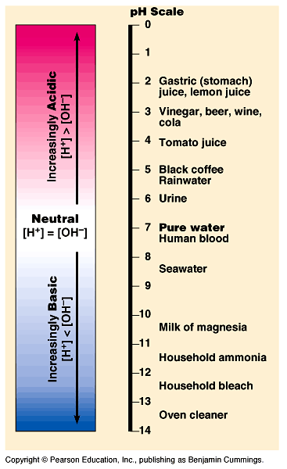
Topic 3: Basic Chemistry
Acids
Bases
pH
Homeostasis
Chemical reactions
C₆H₁₂O₆ + 6O₂ → 6CO₂ + 6H₂O

Slide 7
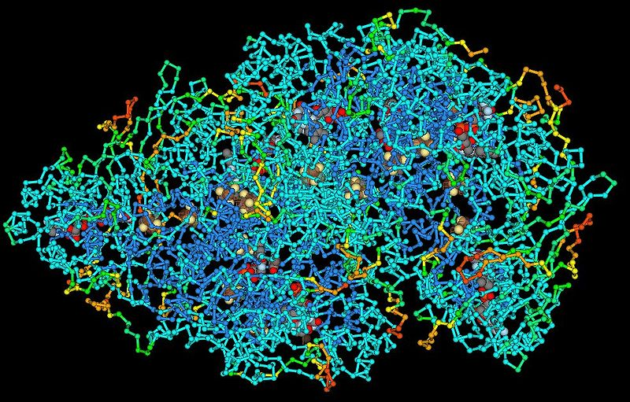
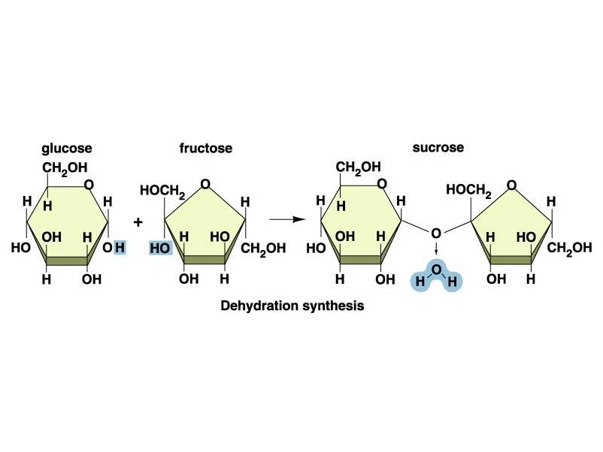
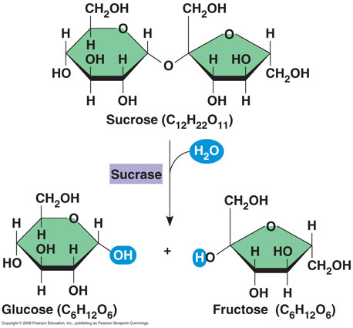
Topic 4: Organic Molecules
Carbon and functional group
Shape Controls function
Macromolecule
Polymerization
Monomer – polymer relationship
Dehydration synthesis
Degradation hydrolysis

Slide 8
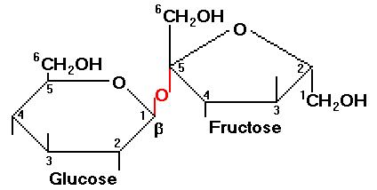
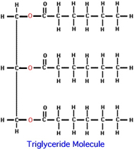
Topic 4: Organic Molecules
Carbohydrates
Monosaccharide, Disaccharide, Polysaccharide
Ex. Glucose, lactose, maltose, sucrose, starch, cellulose, glycogen
Homeostasis connection: insulin and glucagon
Lipids
Triglycerides, Steroids, phospholipids
Saturated vs Unsaturated

Slide 9
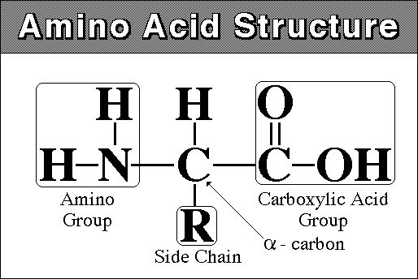
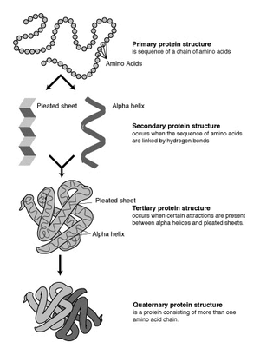
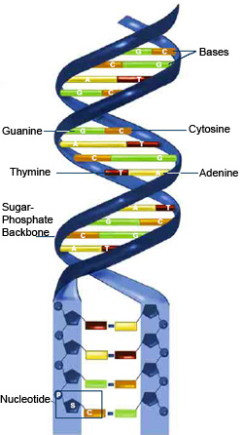
Topic 4: Organic Molecules
Proteins
Amino acids
Ex. Enzymes, structural proteins, cellular transport proteins
Protein folding
Nucleic Acids
Ex. RNA and DNA
nucleotide

Slide 10
Topic 4: Organic Molecules
For all four types…
Identification based on structure or elements present
Major functions….
Nutritionally
In the body
Polymer-monomer relationship

Slide 11
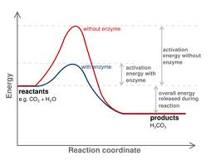
Topic 5: Chemical reactions and Enzymes
Catabolic vs. Anabolic
Exergonic vs. Endergonic
Energy graphs

Slide 12
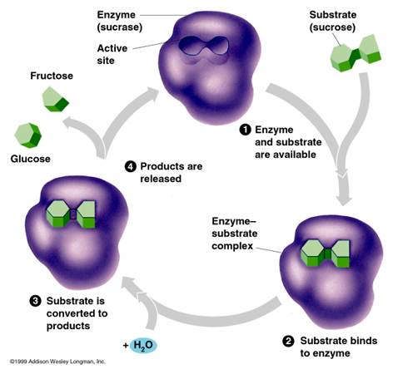
Topic 5: Chemical reactions and Enzymes
Enzymes
Proteins
Biological catalyst
Substrate-active site specificity
Induced fit model
Denaturation
Pepsin Lab
What variables affect enzyme function?

Slide 13
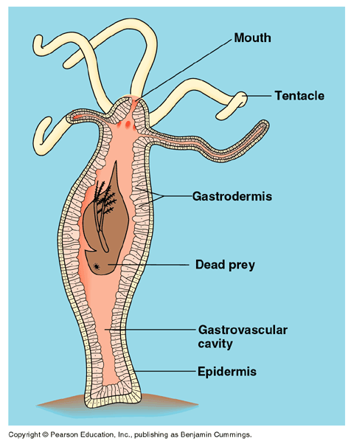
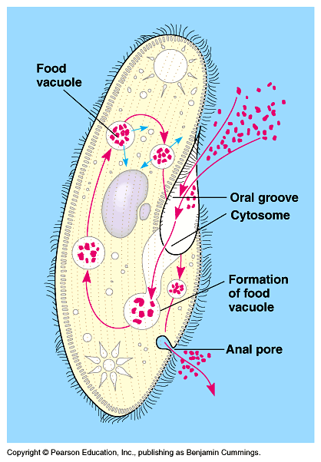
Topic 6: Digestion
Extracellular vs. intracellular
Reason for food
Obtain Energy
Building blocks
Reason for digestion
Break molecules down to monomer level

Slide 14
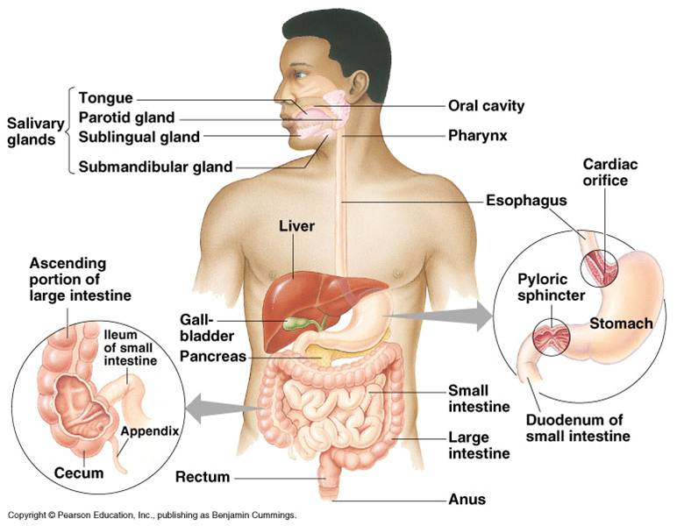
Topic 6: Digestion
Human Digestive System
Four food processing steps
Path of food through system
Digestive tract vs. helper organ
peristalsis
Locations of Mechanical and Chemical digestion
Chewing, churning, emulsifying
Digestive Enzymes
Surface Area Theme
Structure-Function Theme

Slide 15
Topic 7: Methods of Science
Discovery vs. Hypothesis Science
Scientific Method – Controlled Experiments
Variables: Independent, dependent, control
Groups: Experimental, control
If, then hypothesis
Observation vs. Inference

