Slide 1
Meiosis
Topic 3

Slide 2
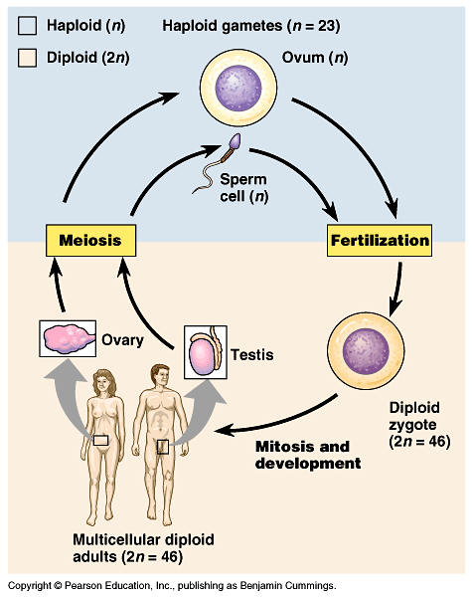
OBJ 13, 14
Gametes –
Sex Cells
23 chromosomes
Ex: Sperm and Ovum
Zygote –
Cell formed from fusion of ovum and sperm
46 chromosomes
Fertilized egg
Somatic Cells –
Cells with all 46 chromosomes
Body cells
Ex: skin cells, muscle cells, nerve cells

Slide 3
Chromosome Number
OBJ 13
Diploid (2n)
Haploid (n)
X
X
X
X
X
X
X
X
X
X
X
Chromosome # = 6
Chromosome # = 3
Cells with 2 complete sets of chromosomes (1 set maternal, 1 set paternal– pairs!)
Cells with 1 complete set of chromosomes (only one of each gene)

Slide 4
Let’s review mitosis…
Using your pipe cleaners, show what the cell will look like during G₁ of interphase
This organism has 2 pairs of chromosomes
Dark colors are maternal (they got this version from mom)
Light colors are paternal (They got this version from dad)
Now, show what the cell will look like right before entering mitosis
Go through all the steps of mitosis until you have 2 new cells

Slide 5
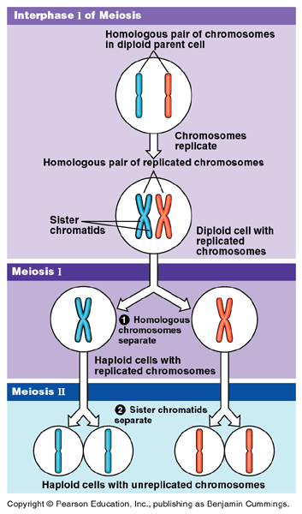
Figure 13.6 Overview of meiosis: how meiosis reduces chromosome number
OBJ 15
Meiosis
Process of cell division that produces gametes
Two successive divisions
Reduces chromosome number in half

Slide 6
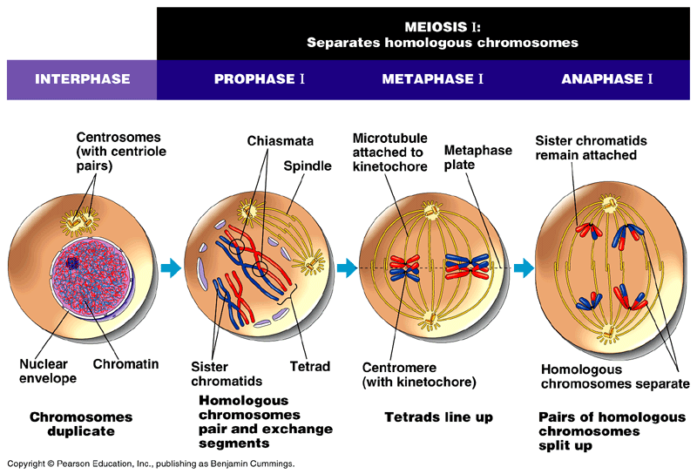
Figure 13.7 The stages of meiotic cell division: Meiosis I
OBJ 15
Notes:
C-block Start here

Slide 7
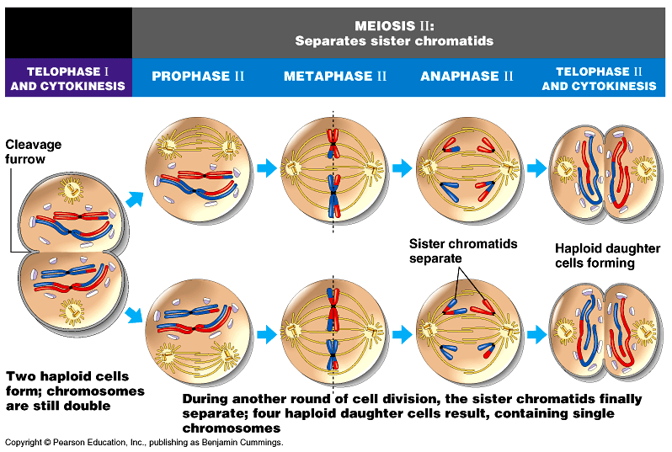
Figure 13.7 The stages of meiotic cell division: Meiosis II
OBJ 15

Slide 8
Activity C: Meiosis with Pipecleaners
G₁ of interphase
End of G₂ of interphase
Metaphase I of Meiosis I (stop here to get teacher approval)
Metaphase II of Meiosis II (stop here to get teacher approval)
End of Meiosis – 4 haploid cells (stop here to get teacher approval)
Compare your gametes to another groups gametes – Are they the same? Should they be the same? Why?
Notes:
E-block (go over this activity)

Slide 9
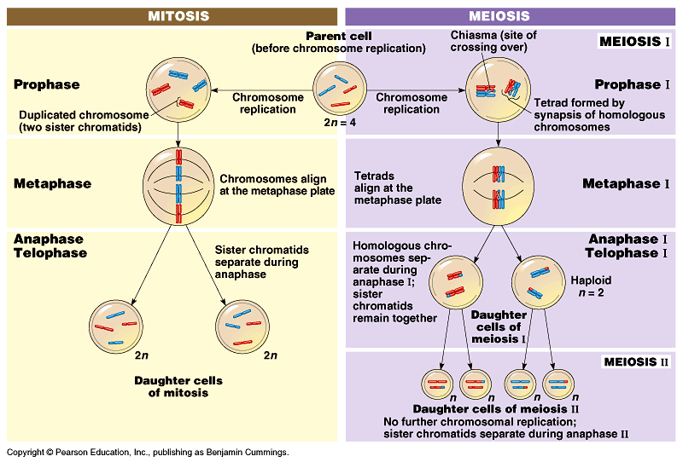
Figure 13.8 A comparison of mitosis and meiosis
OBJ 16

Slide 10
Meiosis vs. Mitosis
OBJ 16
 | Mitosis | Meiosis
Purpose | Growth and repair of tissues, makes more cells | Produces Sex cells
Genetics (parent vs daughters) | Same parent to daughter | Daughter cells have half the genetic information
# cells produced | 2 | 4
Diploid/Haploid | Diploid to Diploid | Diploid to Haploid
Metaphase | Replicated chromosomes line up in the middle of the cell | Metaphase I: homologues pairs line up Metaphase II: replicated chromosomes line up
Anaphase | Replicated chromosomes separate at the centromere | Anaphase I: homologues pairs separate Anaphase II: replicated chromosomes separate at the centromeres

Slide 11
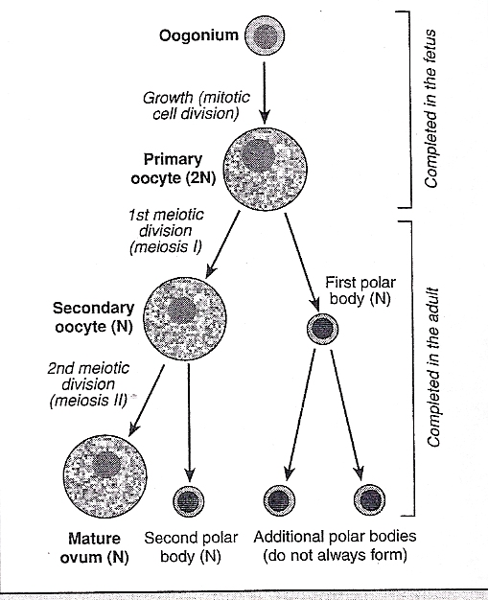
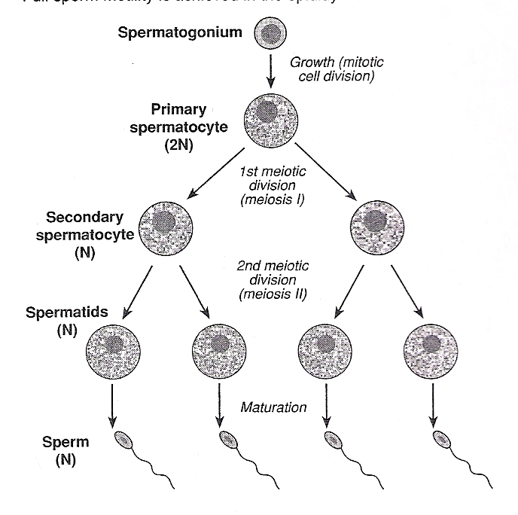
Gametogenesis
Obj 17
Process of forming the unique male and female gametes
Variations on Meiosis

Slide 12
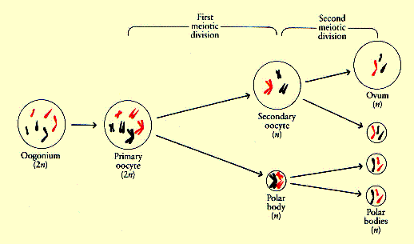
Oogenesis
Obj 17
Meiosis process that forms the ovum
Spindle forms closer to one pole of the dividing cell
Unequal division of cytoplasm during cytokinesis
Produces 3 haploid (n) polar bodies that are not gametes
Produces one haploid Ovum gamete
Occurs in the ovaries
At 20 weeks after conception a female fetus has 6 to 7 million eggs already formed!!

Slide 13
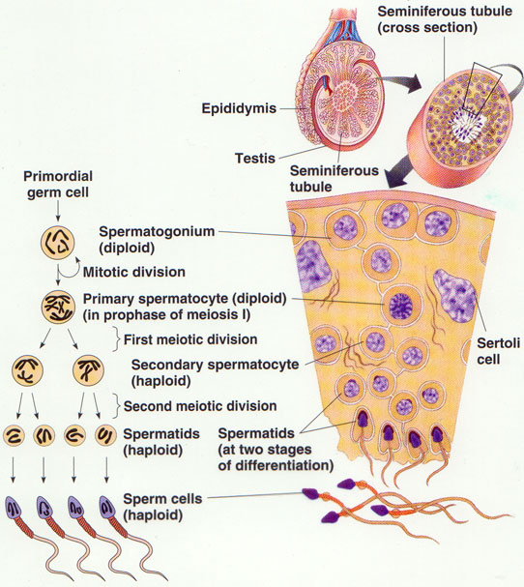
Spermatogenesis
Obj 17
Meiosis process that forms sperm gametes
Produces 4 haploid (n) sperm of equal size
After meiosis further development forms the flagella
Occurs in the testis
millions of sperm per testis per day

Slide 14
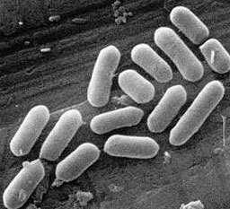
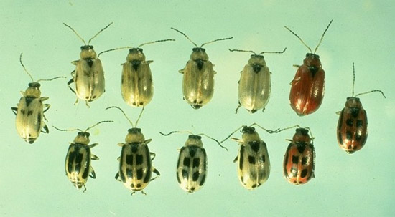
Genetic Variation
OBJ 1, 20
Asexually Reproducing organisms
Offspring are genetic clones of the parents
Variation occurs through mutation and plasmid transfer in bacteria
Sexually Reproducing organisms
Offspring have a mix of parental genetic material
Mixture occurs randomly for each offspring
Therefore offspring are all genetically different

Slide 15
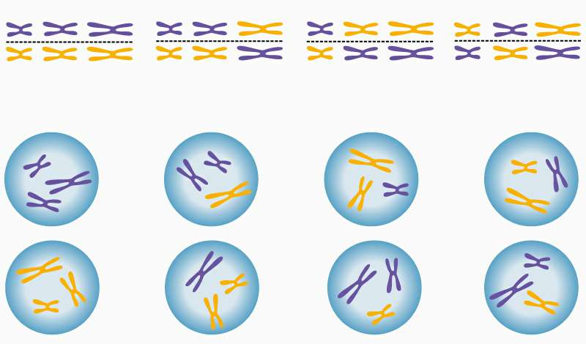
Sources of Variation
OBJ 18
Independent assortment – replicated homologues chromosome pairs line up randomly in metaphase I

Slide 16
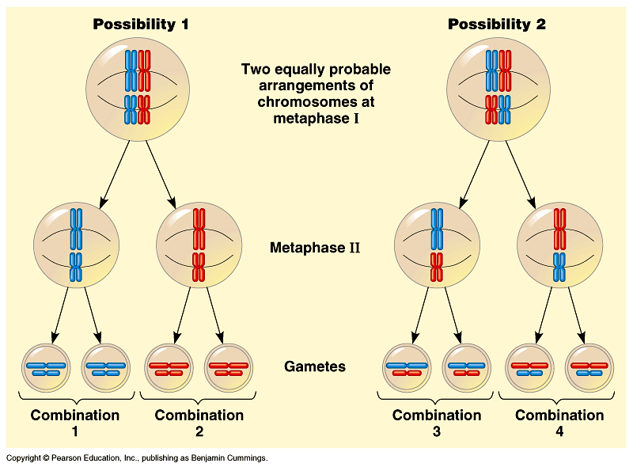
Figure 13.9 The results of alternative arrangements of two homologous chromosome pairs on the metaphase plate in meiosis I
OBJ 17

Slide 17
OBJ 17
OR
metaphase plate
metaphase plate

Slide 18
Sources of Variation
OBJ 18
Random fertilization
who you have children with is up to you
which sperm meets which egg is random
Crossing over – chromosomes being passed on are changing as they trade with their homologues (about 1-3 times per tetrad)
Notes:
G-block start here

Slide 19
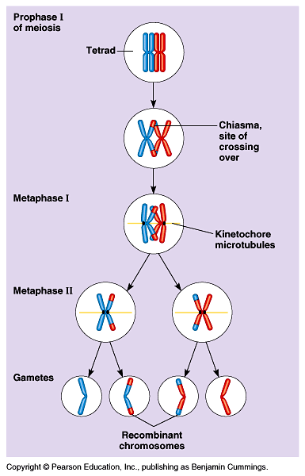
Figure 13.10 The results of crossing over during meiosis
OBJ 17

Slide 20
Crossing Over
OBJ 17
nonsister chromatids
variation

Slide 21
Crossing Over
Crossing-Over
OBJ 17
Section 11-4

Slide 22
Meiosis Anomalies
OBJ 19
Nondisjunction — failure of chromosome separation in anaphase I or II of meiosis
Anaphase I – homologues don’t separate
Anaphase II – sister chromatids don’t separate
Results in gametes with abnormal numbers of chromosomes
(20% to 50% of miscarriages result from fertilization of gametes with abnormal numbers of chromosomes)

Slide 23
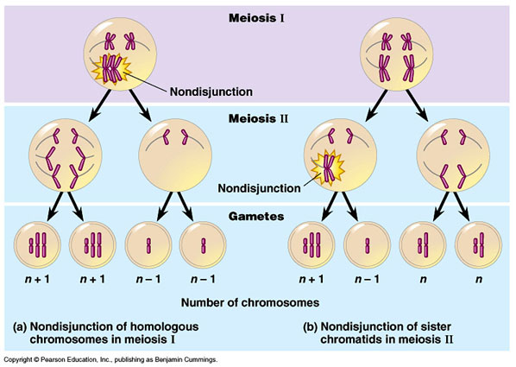
OBJ 19

Slide 24
Meiosis Anomalies (cont.)
OBJ 19
Nondisjunction of autosomes (non-sex chromosomes)
Trisomy 21—Down syndrome
Effects include mental retardation, eyes that slant upward, and heart defects
1 in 700 live births
Trisomy 18 – Edward’s syndrome
All organ systems affected, survive only a few months
1 in 10000 live births

Slide 25
Meiosis Anomalies (cont.)
OBJ 19
Nondisjunction of sex chromosomes
Turner's syndrome (XO)
Short stature
Normal mental development
Typically sterile
Klinefelter's syndrome (XXY)
Male sex organs (possibly non-functioning)
Normal mental and other physical development
XYY males
Somewhat taller
Thought to be more aggressive but since disproven
XXX females
normal development

