Slide 1
Unit 6: Reproduction
Review

Slide 2
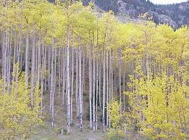
Journal 6-1: A Zillion Ways to Make More and Journal 6-2: Investigating Reproductive Strategies
Reproduction – one of the basic functions of a living thing
Many different strategies exist
Large numbers of offspring, minimal parental care
Small number of offspring, lots of parental care
Internal vs. External fertilization
Internal vs. external gestation
Sexual vs. Asexual reproduction
Organismal Reproduction vs. Cellular Reproduction

Slide 3
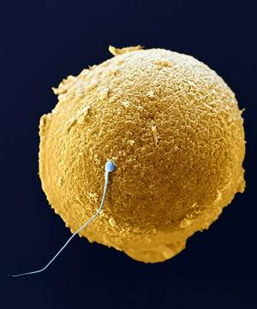
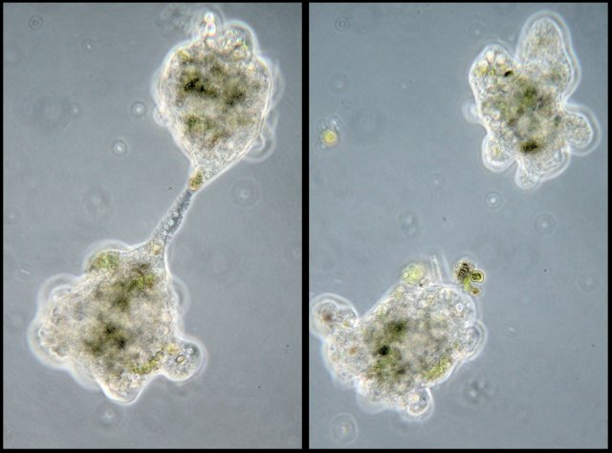
Sexual vs. Asexual Reproduction
Sexual reproduction
Two genetic donors – each contribute half
Produce gametes via meiosis – haploid cells
Fertilization – two gametes fuse to make a diploid zygote
High genetic variation in populations
Asexual reproduction
One genetic donor
Examples.. All based on mitosis
Binary fission
Regeneration
Budding
Vegetative propagation
Low genetic variation in populations

Slide 4
Organismal vs. Cellular Reproduction
Organismal Reproduction
Formation of a new individual of a species
Examples…
Binary fission of bacteria
Plant reproduction
Human Reproduction
Cellular Reproduction
MITOSIS - Cell division
Produces clones

Slide 5
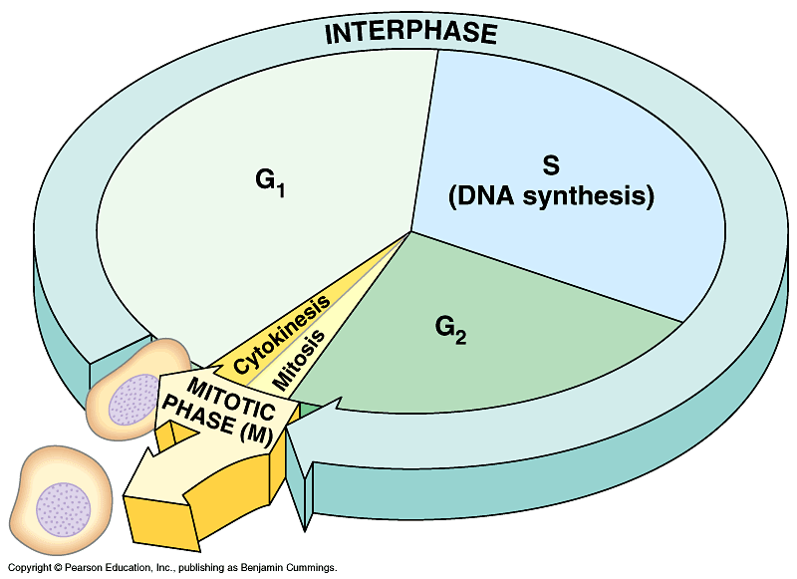
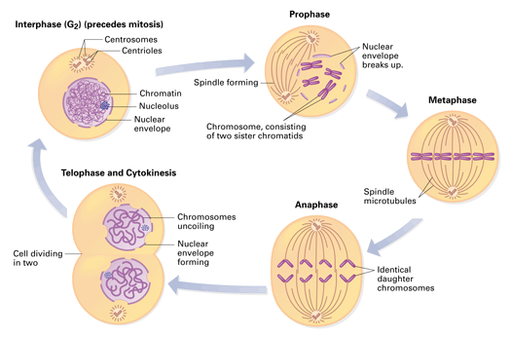
Journal 6-3: Mitosis and the Cell Cycle Plus, notes
Cell cycle
Interphase – regular cell function, preparation for division
Mitosis – further divided into phases that describe the movements of the chromosomes (P, M, A, T)
Cytokinesis – separation of the cytoplasm, i.e. formation of two cells

Slide 6
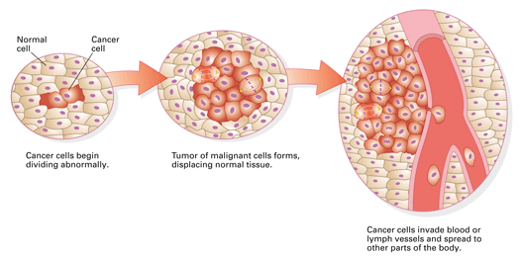
Journal 6-4: Cancer Webquest
Cancer – uncontrolled cellular division
Forms tumors that interrupt normal tissue function
Occurs because mutations accumulate in genes that regulate cell division
Mutations can be inherited but are usually due to environmental influences.
Examples of mutagens
Chemicals in cigarette smoke
UV light

Slide 7
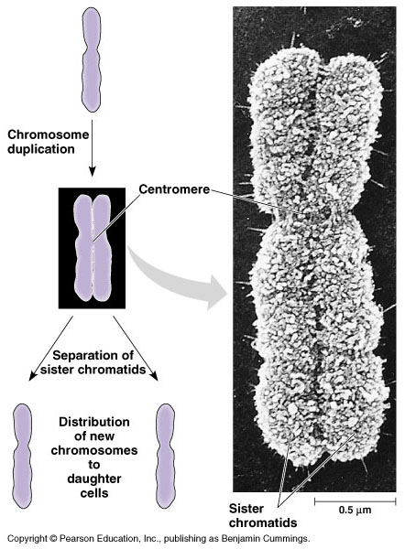
Chromosome Terminology
UNreplicated Chromosome
DNA replication
Replicated Chromosome
Sister Chromatids
UNreplicated Chromosomes

Slide 8
Chromosome Terminology
Tetrad = replicated Homologous pair

Slide 9
Journal 6-5: Formation of Gametes
Meiosis – the process of cell division that forms haploid gametes
Occurs in sexually reproducing organisms
Two cell divisions – reduces genetic information by half
In humans….
Spermatogenesis - forms sperm in the testis
Oogenesis – forms ova in the ovaries
Mitosis vs. Meiosis – both describe movement of chromosomes, broken into phases
Compare metaphase, metaphase I, metaphase II
Compare final products
Compare locations in the organism

Slide 10
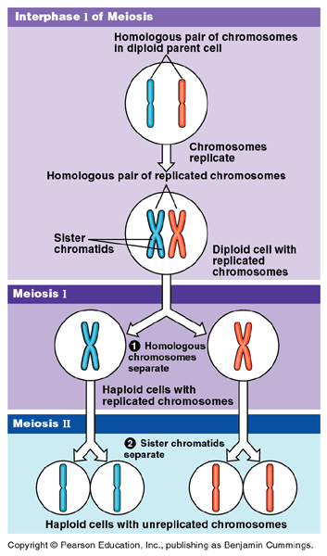

Slide 11
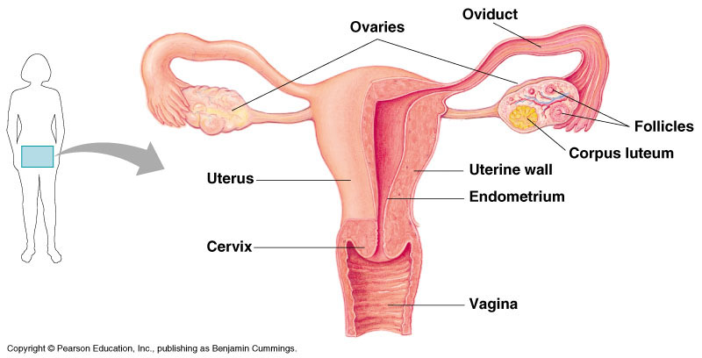
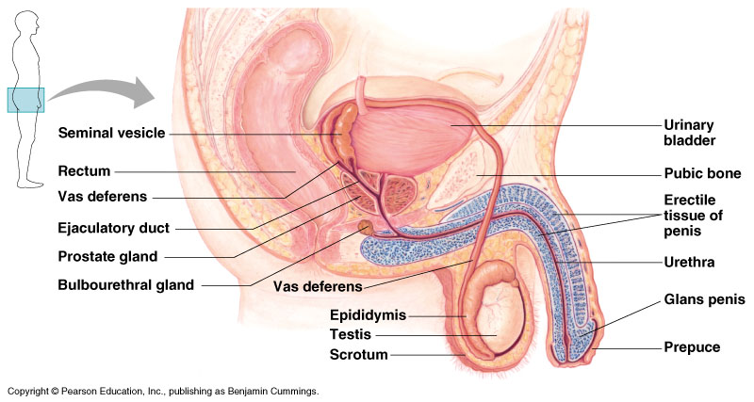
Notes: Human Reproductive Anatomy
Trace the path of the gamete
Review structures listed in your packet
Structure-function-labeling questions – MC or word bank format

Slide 12
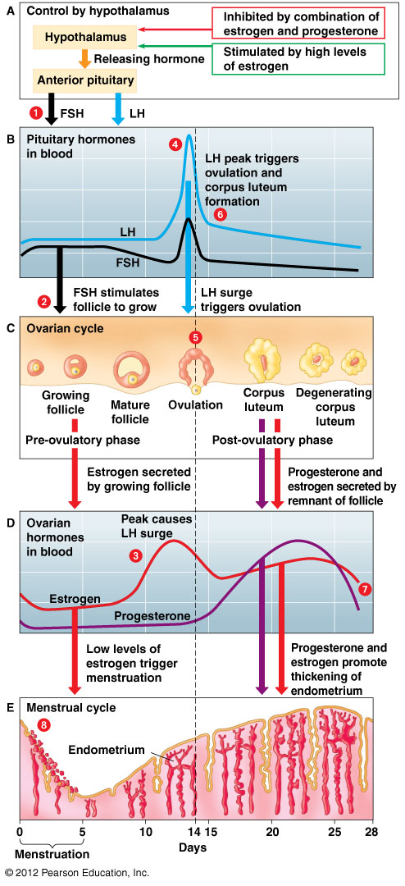
Journal 6-6: Hormonal Control of Reproductive Cycles, plus Notes
Review the table in your packet and the female reproductive cycle figure
Relate the hormone (signaling molecule) to the change in the body
Example: elevated estrogen thickens the endometrium of the uterus
Male Hormones – Where are they made? What do they do?
FSH
LH
Testosterone
Female Hormones – Where are they made? What do they do?
FSH
LH
Estrogen
Progesterone

Slide 13
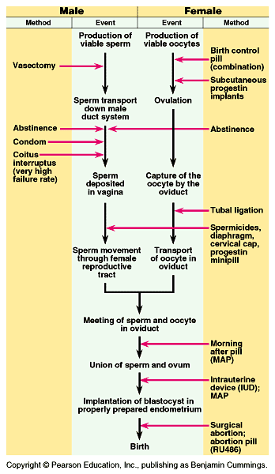
Journal 6-7: Biological Basis of Birth control (HW)
Behavioral methods vs. Barrier methods vs. Chemical methods
Be able to categorize a method based on a description
How does the method work biologically?

Slide 14
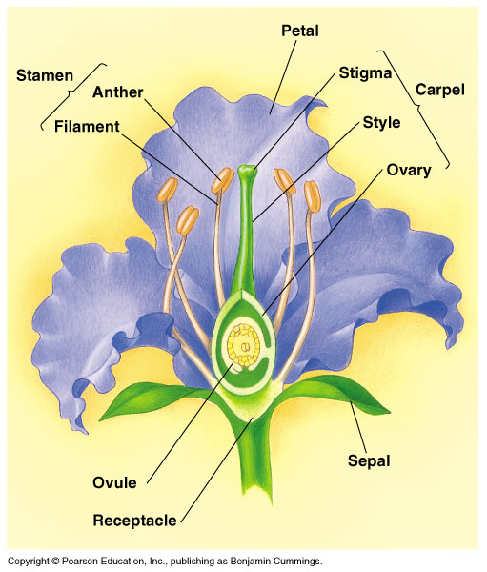
Lab 6-1: Flower and Seed Dissection and Plant reproduction notes
Location of meiosis?
Flower anatomy
Structure-function-labeling questions
MC or word bank questions
Seed vs. Fruit

