Slide 1
Unit 6: Reproduction

Slide 2
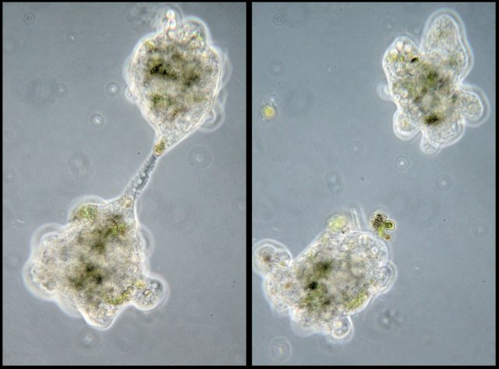
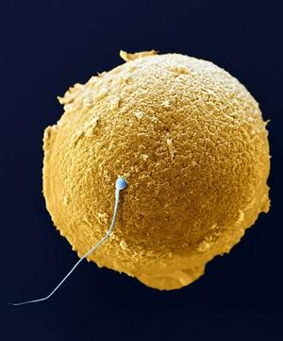
Reproduction
Biological process that creates new individuals from existing ones.
Asexual Reproduction
Formation of genetically identical offspring
One genetic donor (parent)
Lower Genetic variation in offspring
Sexual Reproduction
Two genetic donors (two parents)
Produces genetically different offspring
Higher genetic variation in offspring

Slide 3
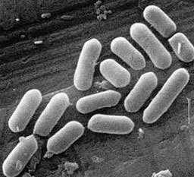
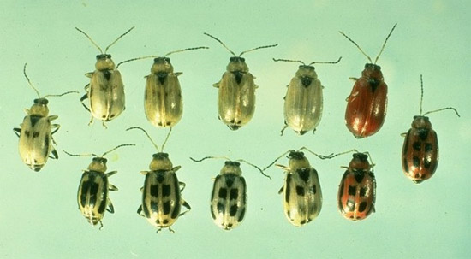
Genetic Variation
Asexually Reproducing organisms
Offspring are genetic clones of the parents
Variation occurs through mutation and plasmid transfer in bacteria
Sexually Reproducing organisms
Offspring have a mix of parental genetic material
Mixture occurs randomly for each offspring
Therefore offspring are all genetically different

Slide 4
Cellular vs. Organismal Reproduction
Cellular Reproduction
Organismal Reproduction
Reproduction of cells
Multicellular organisms are constantly reproducing cells
Example: We are constantly sheading dead skin cells. New cells are reproduced to replace the dead ones.
Reproduction of a new individual of a species.
For single celled organism cellular reproduction and organismal reproduction are the same!

Slide 5
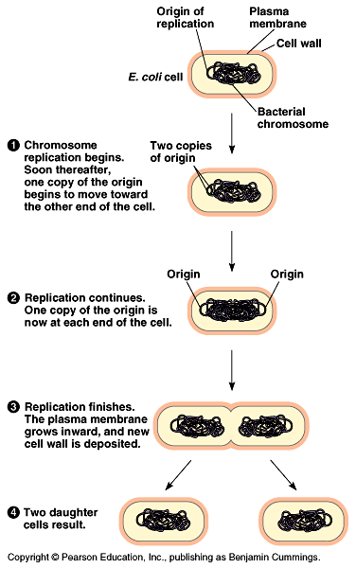
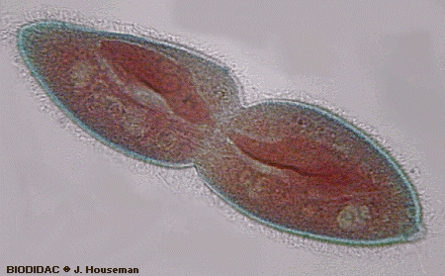
Binary Fission
Asexual Reproduction in bacteria
One parent bacterium becomes two daughter bacteria
DNA must replicate and move to the poles of the bacteria
Cytoplasm splits as new cell membrane and cell wall forms

Slide 6
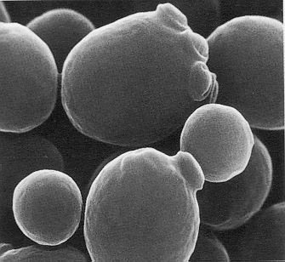
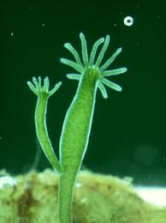
Budding
Asexual reproduction
Genetic clone develops as an out growth from the parental organism
Ex. Yeast
Ex. Hydra

Slide 7
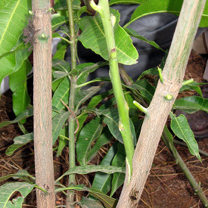
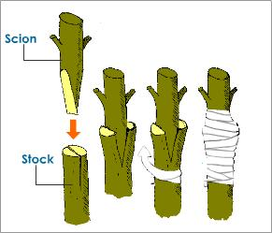
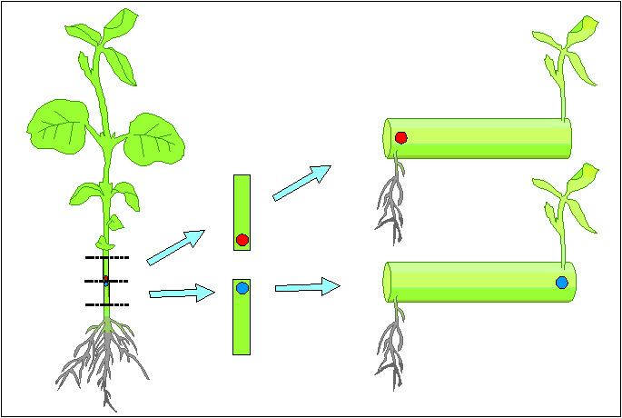
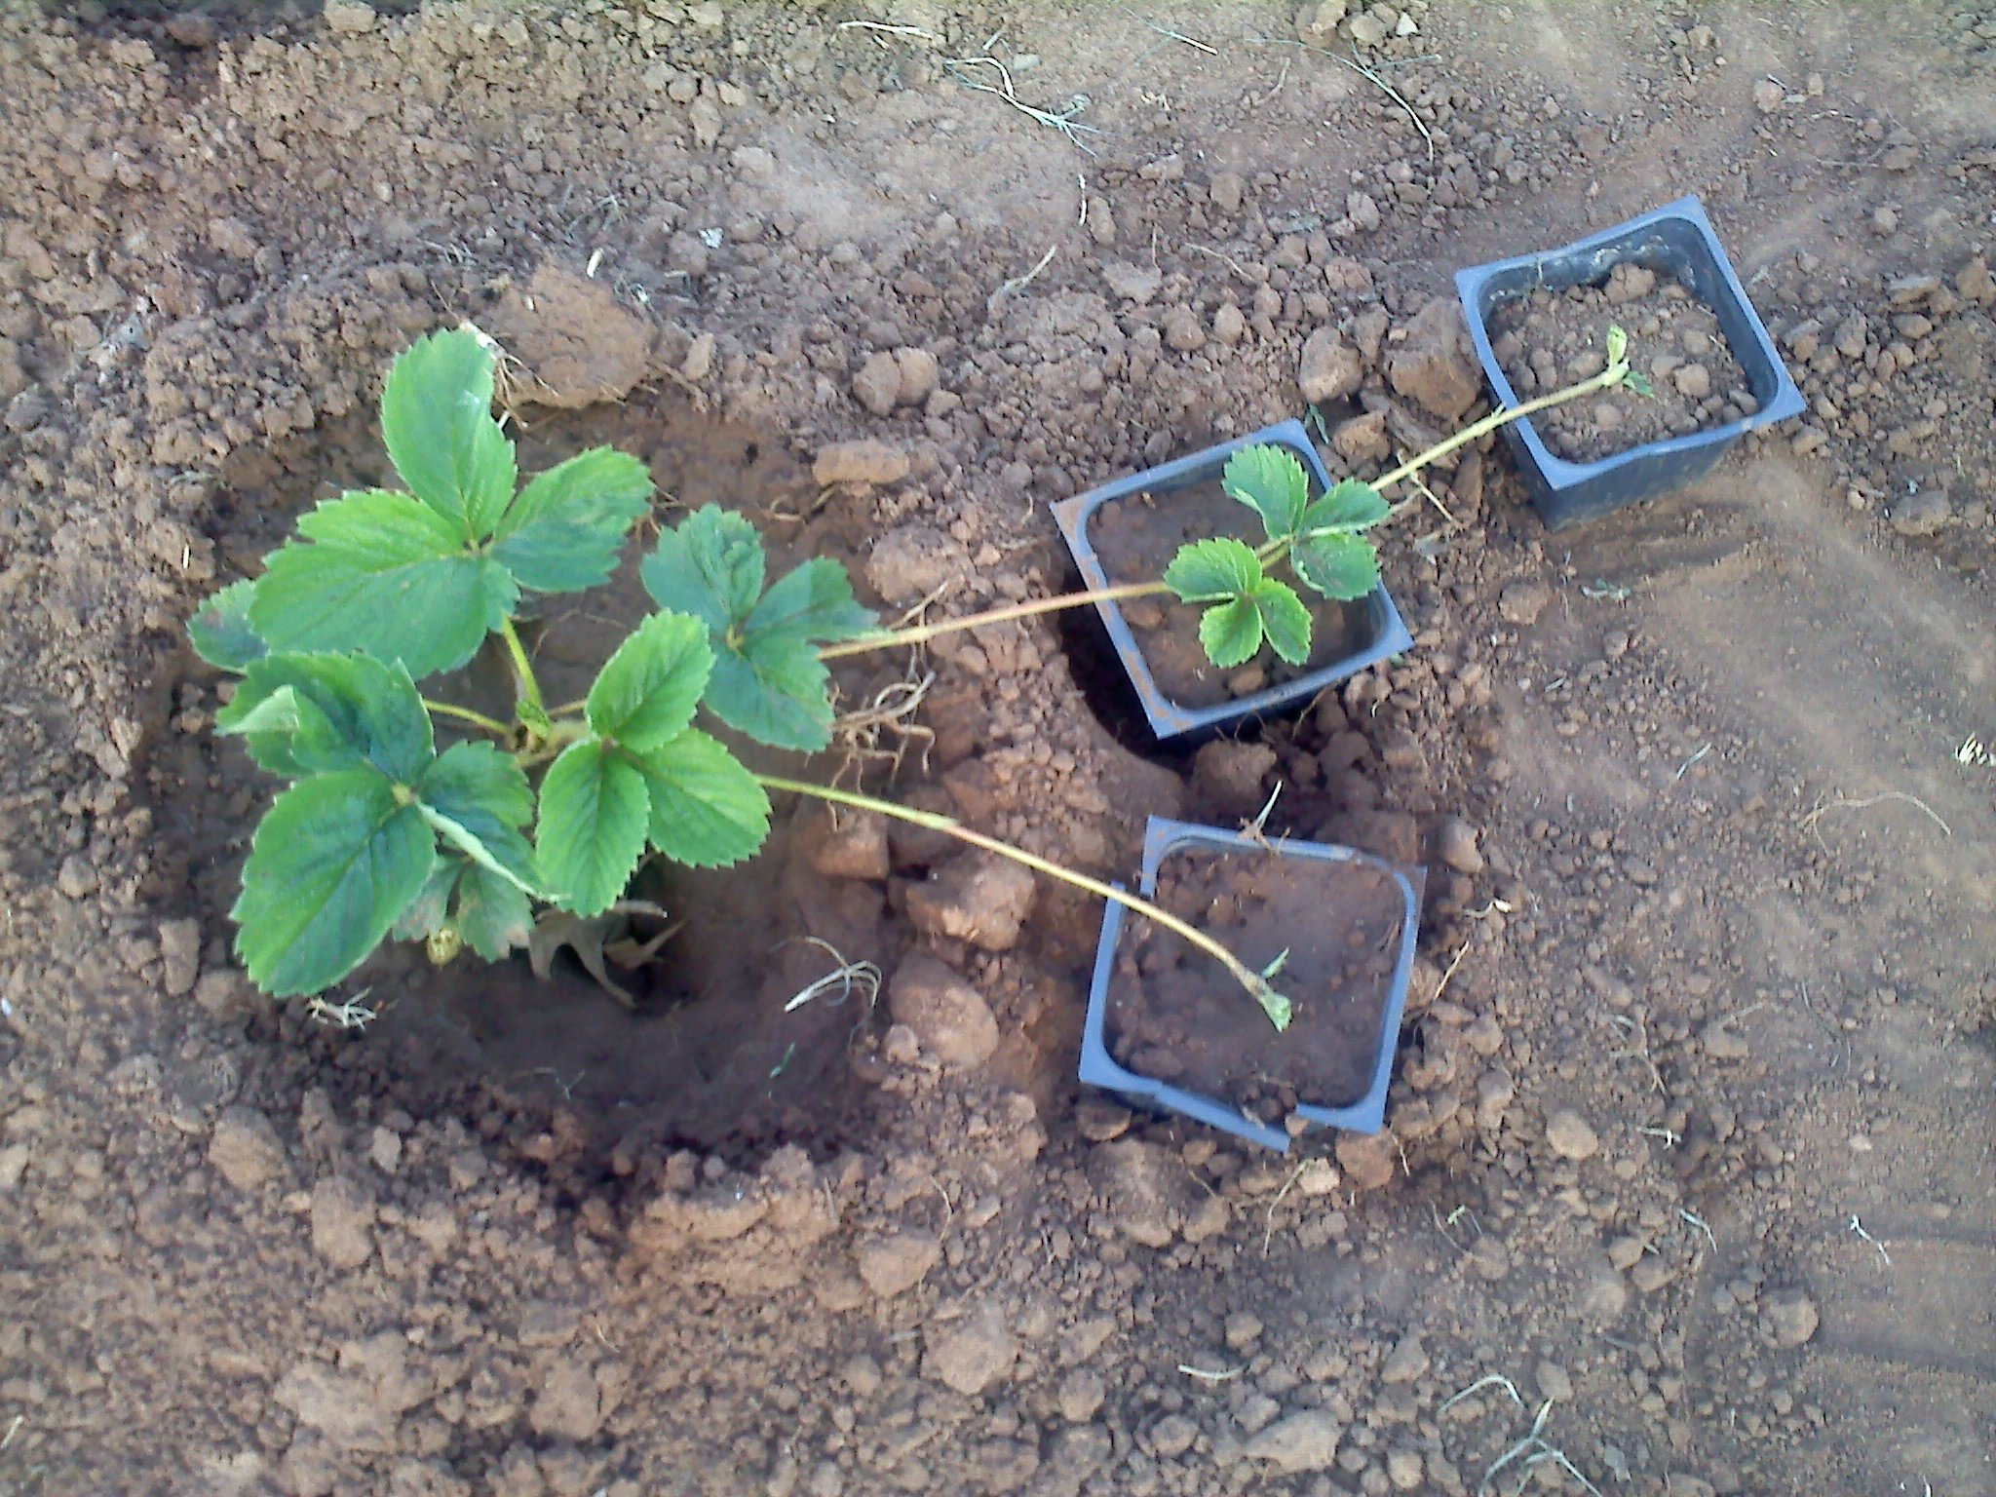
Vegetative Propagation
Asexual reproduction in plants
Some plant tissues can develop into full plants
Cuttings
Grafting
Some plants reproduce through under ground root networks or above ground shoots

Slide 8
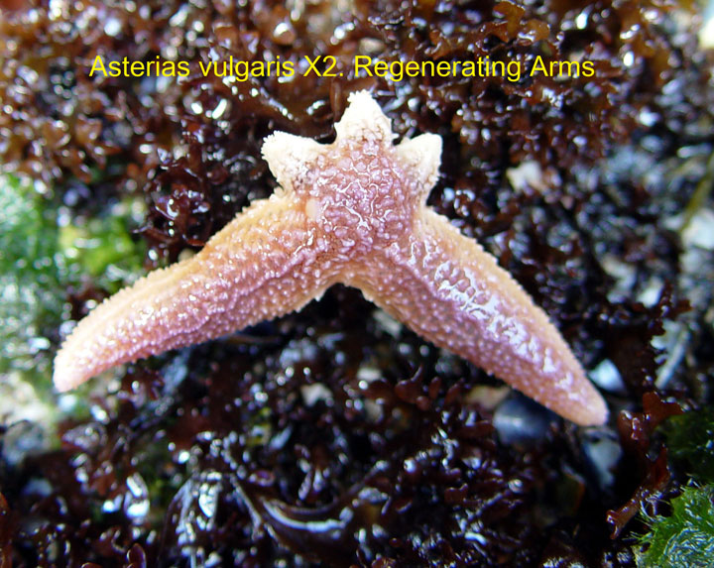
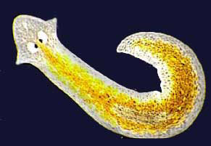
Regeneration
Asexual reproduction through regrowth of tissues
Only reproduction if two viable organisms result from fragmentation
Ex. Sea Stars
Ex. Planaria
Note: Both Sea Stars and Planaria can reproduce sexually also!!!

