Slide 1
Micropipettor
Practice Day

Slide 2
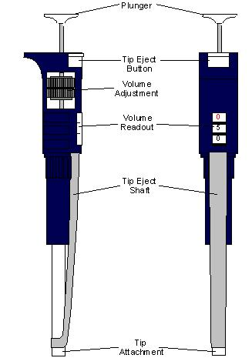
Parts

Slide 3
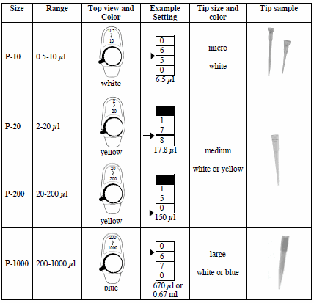
Types

Slide 4
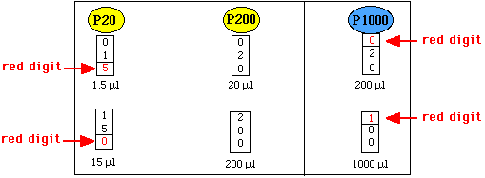
Settings

Slide 5
Activity I: Transferring small volumes
Use a P20 to transfer small amounts of 2X loading dye on to filter paper.
Create a series of dots
Volumes all in microlitters: 1, 3, 5, 7, 10, 15 and 20.
Objectives
Set pipette correctly
Slow and steady extraction and dispersal

Slide 6
Activity II: Transferring small volumes from tube to tube
Use a P200 to transfer 4 small volumes of separate solutions into an empty eppendorf tube.
Objectives
Set pipette correctly
Accurate and precise transfer of small volumes
Steps
Label 2 empty eppendorf tubes (E and F) and fill them with the volumes given below (volumes in microliters)
Check your work: Set P200 to 200 microliters. Draw out all 200 microliters from tube E and F. You should see no sample in the tube and no air at the end of the tip
Tube | Solution 1 | Solution 2 | Solution 3 | Solution 4
E | 20 | 40 | 30 | 110
F | 30 | 50 | 70 | 50

Slide 7
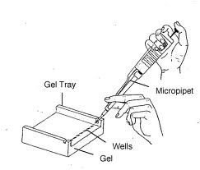
Activity III: Transferring a small volume into a well
Use a P100 or a P200 to transfer 30 microliters of 2x loading dye into a well of a practice gel

