Slide 1
Lab 1-1: Roly Poly Lab
Day 1: Introduction to Isopods and Brainstorming an Experiment

Slide 2
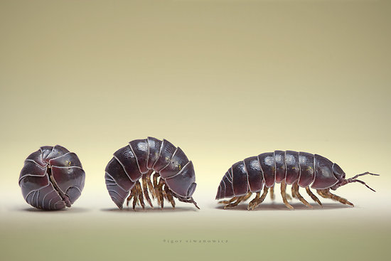
Introduction to Isopods
Read Handling instructions and Background information in Packet

Slide 3
Your Group Goal for todays class time
Plan an experiment around isopod behavior using the equipment that is available to you.
Possible environmental conditions to test.
Light exposure
Temperature
Surface preference
Use the Day 1 instructions in the packet to plan all the necessary components of the experiment. Call me over to approve your experiment when you are done.
Honor Day 1 Homework – Type a detailed procedure bring 2 copies to class tomorrow

Slide 4
Day 2: Testing your Procedure and Editing
Procedure Detail Activity:
Get into your lab groups.
Exchange procedures with your group members.
Perform the steps of the procedure exactly as they are written.
The author of the procedure cannot speak during this step.
The author should take notes on his/her second copy of the procedure. What areas were unclear to your group members? What details need to be included? Are there any missing steps.
Run through all the procedures in your groups.
Discuss how to take the best parts of each procedure and make one master procedure that you will use tomorrow.
Incorporate the common data table into your procedure.

Slide 5
Day 2: My Ideas on Data Collection
Manipulated Variable: Varies Group to group
Responding variable: Location of Roly Poly’s in the Choice chamber (Same for all groups)
Suggestion – Start with a total of 4 roly poly’s, 2 on each side
Sample Size - Total number of observations
2 experimental group trials
2 control group trials

Slide 6
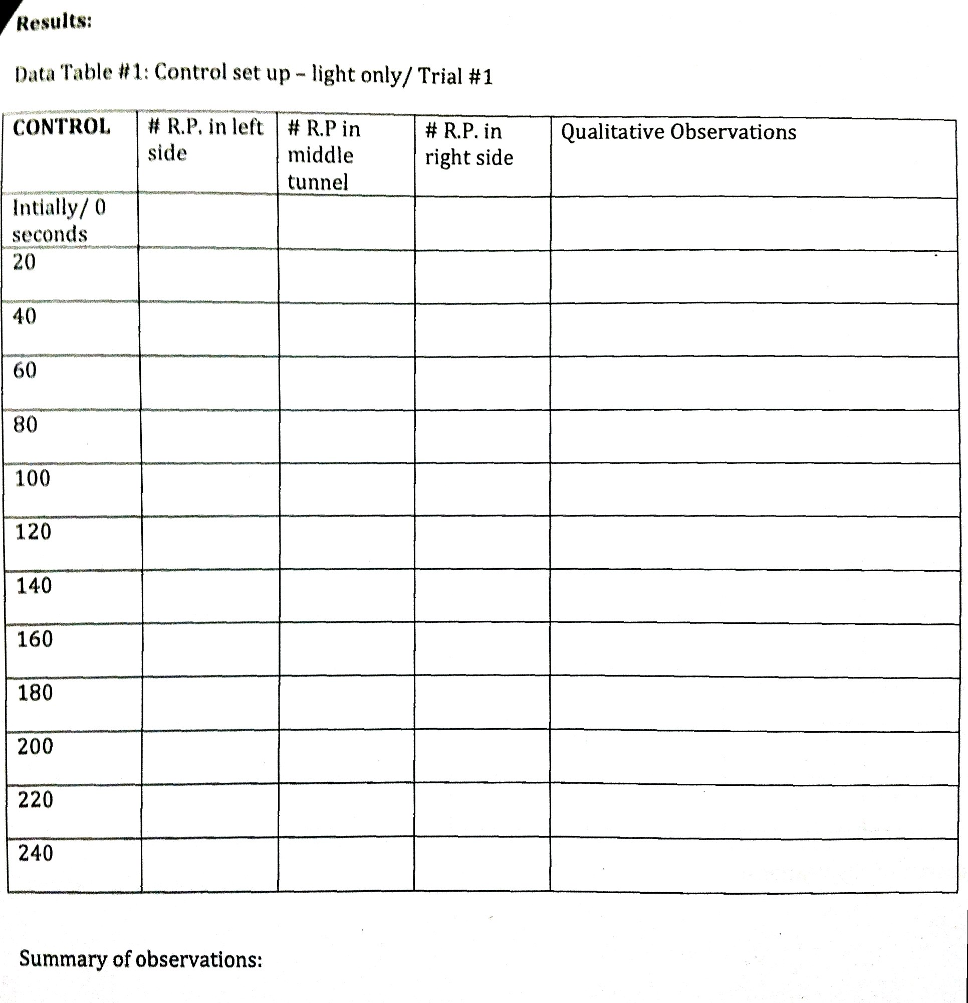
Common Data Table
You will get 4 of these
2

