Slide 1
Journal 5-6: A Closer Look at Protein Synthesis
And Review of Journal 5-5

Slide 2
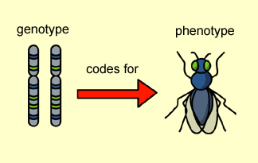
Genes and Traits
Genes – section of DNA that codes for a protein
~21,000 proteins (only!)
Genotype - Letters in your DNA
Ex. Gene mutation that causes sickle cell
Phenotype - physical trait or characteristics
Ex: Symptoms of Sickle Cell
Central Dogma of Biology:
DNA RNA Protein
genotype
phenotype
Notes:
Genotype = genetic makeup (info in DNA)
Phenotype = actual trait
DNA specifies traits by coding for proteins
One gene for one protein (one gene for one polypeptide)
A typical gene has hundreds or thousands of nucleotides in a specific sequence

Slide 3
Written Language is a code!
ABCDEFGHIJKLMNOPQRSTUVWXYZ
26 characters
Specific sequences are required to communicate.
RACECAR has meaning but…..
RRAACCE does not
DNA has a 4 base code….
ATCG
Specific sequences are required to produce specific proteins

Slide 4
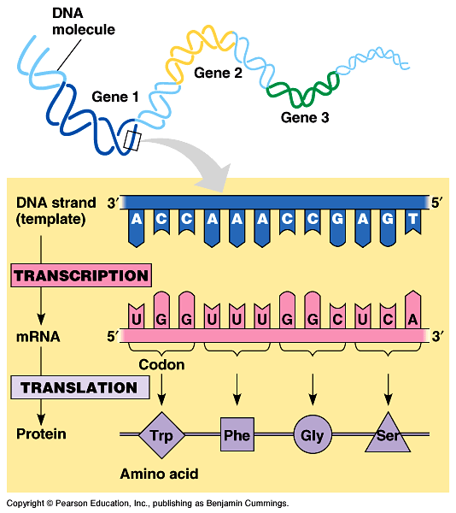
Gene Expression = Protein Synthesis
2 Steps
Transcription
DNA sequence converted to mRNA sequence
Translation
mRNA sequence converted to amino acid sequence

Slide 5
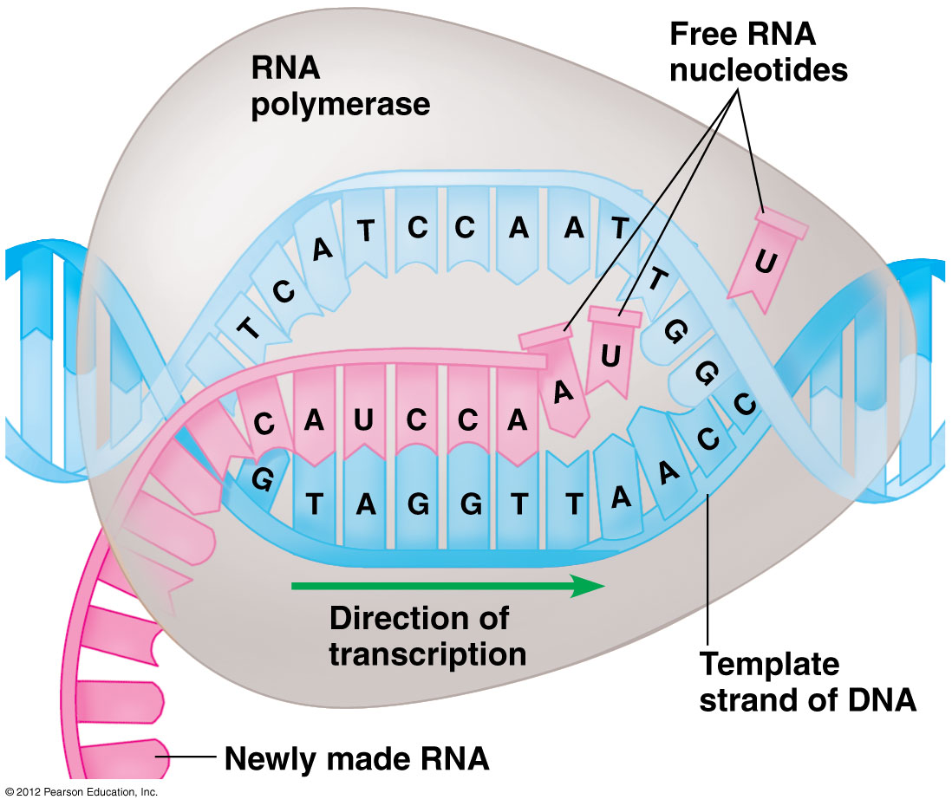
Protein Synthesis: Cellular components
Transcription
RNA polymerase – Enzyme that converts DNA sequence to mRNA sequence
Process occurs in nucleus

Slide 6
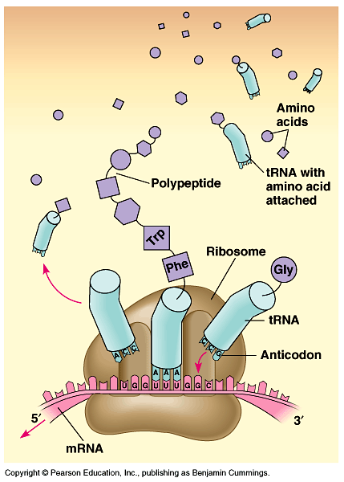
Protein Synthesis: Cellular Components
Translation
Ribosome (rRNA) – Cell structure that converts mRNA sequence into amino acid sequence, makes the polypeptide (protein)
Transfer RNA (tRNA) – carries amino acids into the correct position
Codon to anticodon pairing

Slide 7
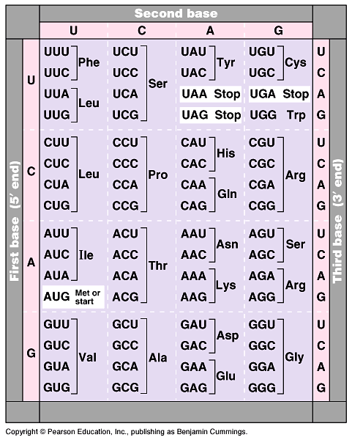
Genetic Code
Codons and corresponding Amino Acids
Redundant code
Notes:
mRNA only!!

Slide 8
thesunwashotbuttheoldmandidnotgethishat
the sun was hot but the old man did not get his hat
the sun was hot but the ole man did not get his hat
the sun was hot but the old man did not get his cat
the sun was hot but the old ma. did not get his hat
thd esu nwa sho tbu tth eol dma ndi dno tge thi sha t

