Slide 1
GMO Investigation Lab
What is in my food?

Slide 2
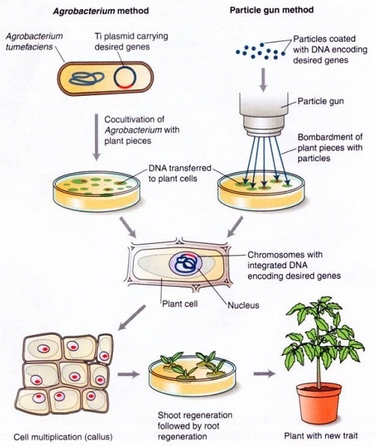
Genetically Modified Organisms

Slide 3
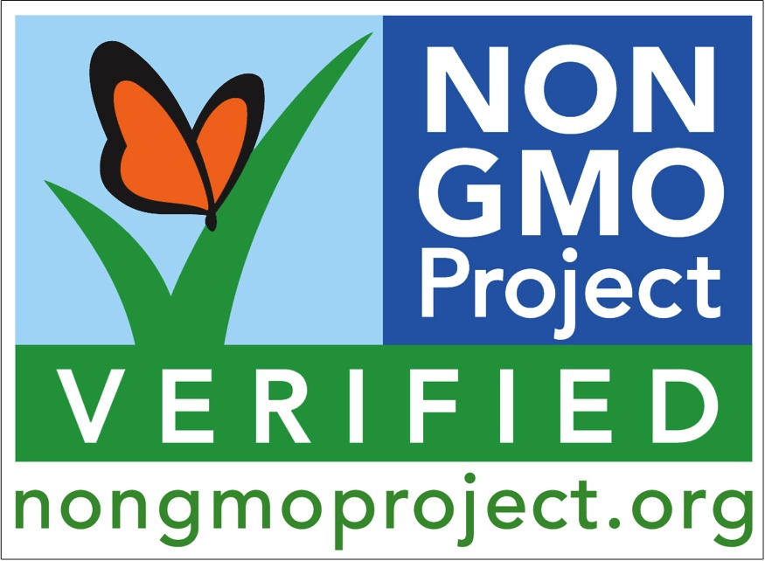
Are GMO’s bad?
What does Monsanto say?
What does Greenpeace say?
What does literature say? (just a sample)
Environment
Bt toxin, 2, 3
Roundup toxicology
Recombinant DNA and Digestion

Slide 4
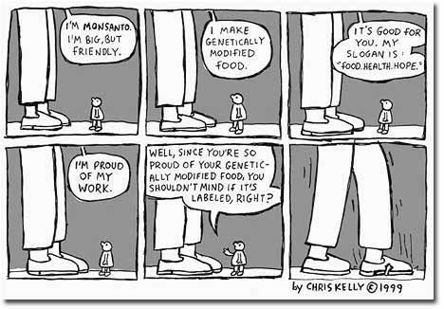

Slide 5
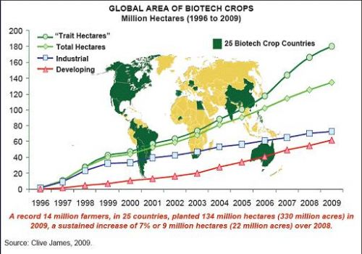

Slide 6
How can you detect a GMO crop?
Look for the gene!
Two common GMO associated sequence
35S promoter for the cauliflower mosaic virus
Terminator for nopaline synthase (NOS) from Agrobacterium tumefaciens
Three steps
Extract DNA from food sample
Amplify targeted regions of DNA (see above)
Compare DNA from known GMOs and non GMOs to an unknown

Slide 7
GMO Investigation - Lab procedures
Day 1: DNA extraction from food samples
Day 2: PCR amplification of target
Day 3: Electrophoresis of PCR products
Day 4: Analysis of Gels

Slide 8
Which foods yield viable plant DNA?
Very Reliable | Reliable | Less Reliable | Very Difficult / Not Possible
Fresh corn | Veggie sausages | Veggie burgers | Oil
Fresh papaya | Tortilla chips | Fried corn snacks | Salad dressing
Corn bread mix | Flavored tortilla chips | Popcorn | Cereal (eg cornflakes)
Corn meal | Puffed corn snacks | Fries | Wheat flour
Soy flour | Meatballs and burgers containing soy protein | Potato chips
 | Soy-based protein drinks/powders
Notes:
You can search which foods/students projects/ will contain GM. BioRad scientists have already figured out which foods yield better results
DNA is very very stable… Jurassic park DNA 65M years, think about the torture a dorito Corn chip has gone through and you cans still get DNA out of it!!!!

