Slide 1
Eutrophication
The Nitrogen and Phosphorous Cycles

Slide 2
Eutrophication
What normally limits algae growth in a lake or river?
Eutrophication – the increase of chemical nutrients so that they no longer limit growth
Nitrogen compounds
Phosphorous compounds

Slide 3
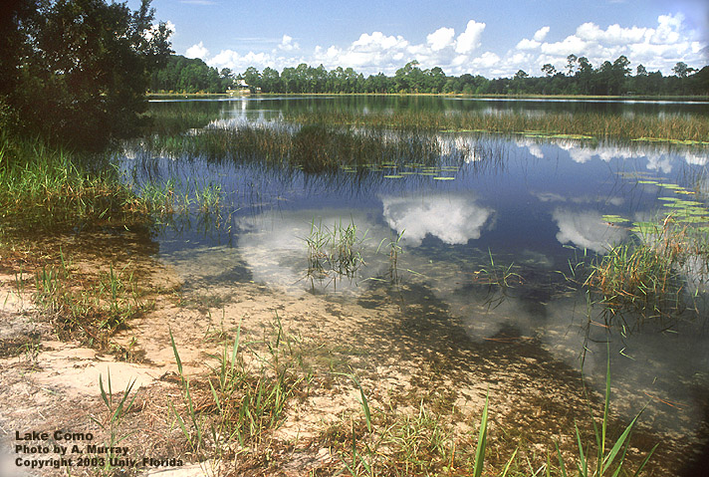
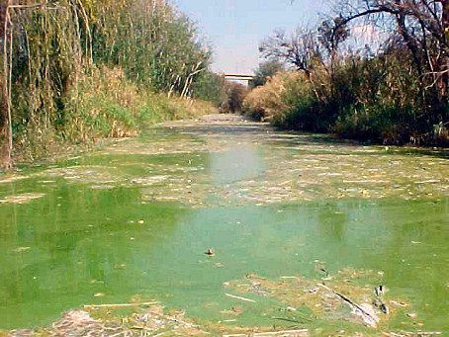
Eutrophication
Oligotrophic Lake (healthy)
Eutrophic Lake (unhealthy)

Slide 4
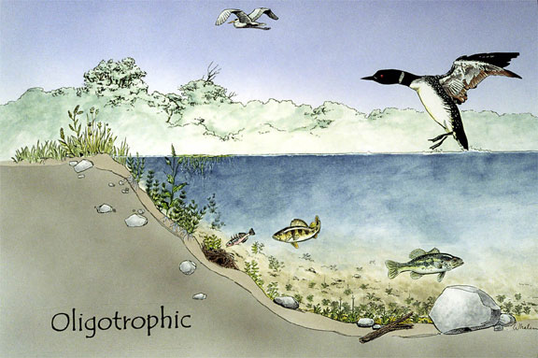
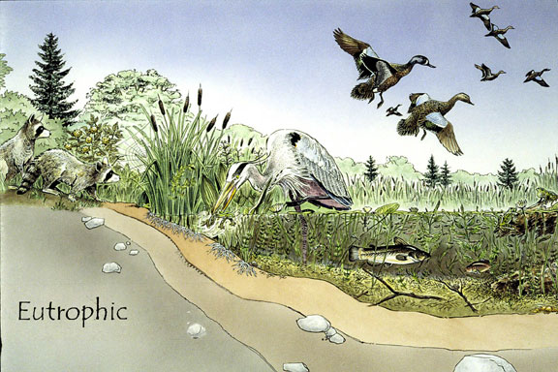
Eutrophication
Oligotrophic Lake (healthy)
Eutrophic Lake (unhealthy)
Low nutrients, small populations, high biodiversity, high value
High nutrients, low biodiversity, lots of plants and algae, few animals, low value

Slide 5
How does this happen?
Increase in nutrient levels (Phosphorus and Nitrogen)
Algal bloom (increased competition and murky water)
Death of algae
Dissolved oxygen levels drop
Bacteria decompose dead matter and use up a lot of oxygen
Fish and other aquatic animals die

Slide 6
Nitrogen Cycle
The movement of nitrogen through the biosphere.
Nitrogen is a necessary part of many biological molecules…
Proteins (muscle, hormones, make up most of the cell
DNA (information molecule)
Most nitrogen is in the form of N₂
78% of the air is nitrogen gas
Nitrogen compounds are found in fertilizers
Natural – manure, decomposing organic material
Human made – Miracle grow, Scotts

Slide 7
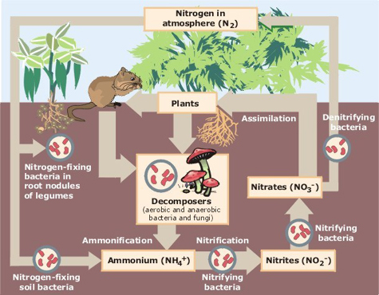
Nitrogen Cycle
Some Soil Bacteria can take Nitrogen from the air and make nitrogen compounds
Legumes - symbiotic relationship between plant and bacteria
Nitrogen containing compounds are a main part of fertilizer
Plants take up nitrogen from the soil
Animals get nitrogen from eating
Decomposition of organic matter
Returns nitrogen compounds to the soil

Slide 8
Phosphorus Cycle
Movement of Phosphorous in the biosphere
Phosphorous is an essential element in DNA and RNA
Most phosphorus exists in molecules that make up the soil, rock and the ocean floor
Phosphorus compounds are used in detergents and fertilizers

Slide 9
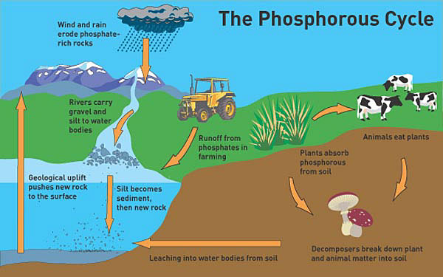
Erosion
Runoff
Passed in Food Chain
Plant uptake
Decomposers
Erosion deposits phosphates into water and land
Runoff from farms and homes into water
Plants obtain it from the soil
Passed through the food chain
Decomposers deposit in into the soil

Slide 10
