Slide 1
Unit 2: Ecology–Part I: Communities and Populations
Quiz Review

Slide 2
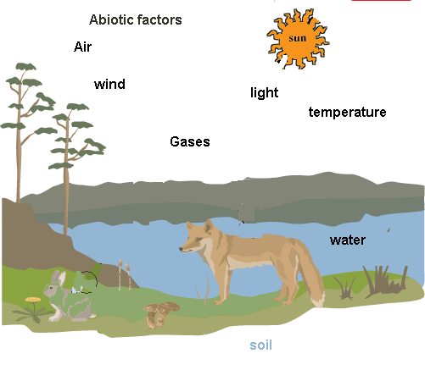
Journal 2-1: Interactions in the World Around US
Ecosystems
Biotic vs. Abiotic
Ecology is a collection of interactions
Humans have a big impact

Slide 3
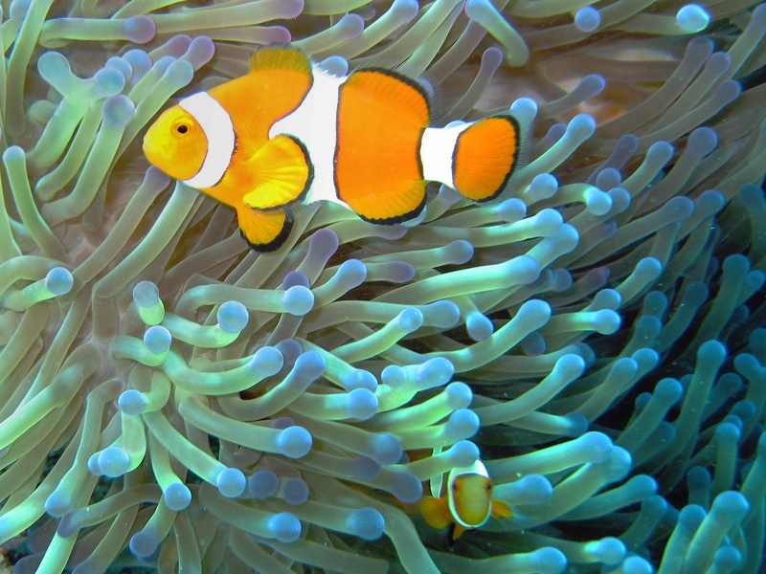
Community Ecology Notes
Population vs. Community
Habitat vs. Niche
Types of interactions in the community
Competition
Predation
Symbiosis

Slide 4
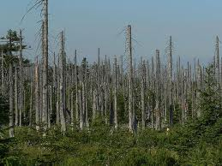
Journal 2-2: Fish Kill Mystery
BIG IDEA
Real world ecological scenarios are complex and involve many types of interactions.
Concepts introduced
Acid Rain
Food Chains
Dissolved oxygen

Slide 5
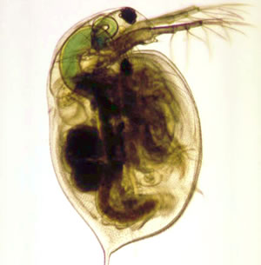
Lab 2-1: Fish Kill pH Lab
pH scale – measure of acidity
Exploring pH of various substances
Exploring affect of acid on organisms behavior

Slide 6
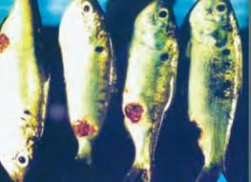
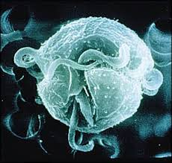
Journal 2-3: Fish Kill Solved
Parasite protist Pfiesteria killed the fish!!
Solving the mystery required a complete understanding of the complex interactions of the estuary ecosystem

Slide 7
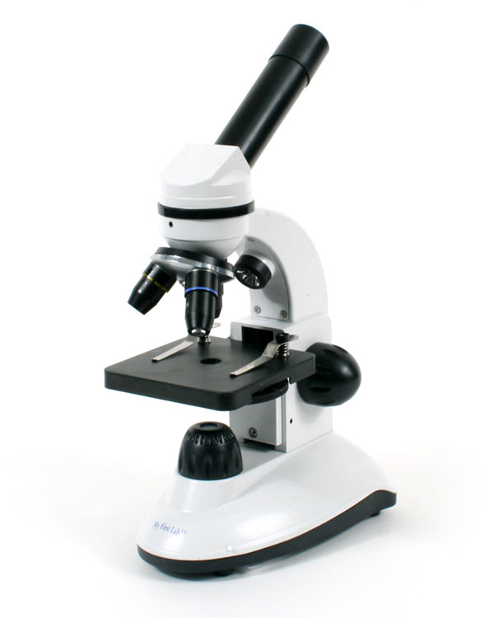
Lab 2-2: Exploring Pond Life
Microscopes – use and function
Major Parts
Observations of living things

Slide 8
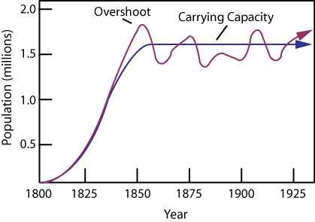
Population Ecology Notes
Exponential vs Logistic population growth
Limiting Factors
Carrying capacity

Slide 9
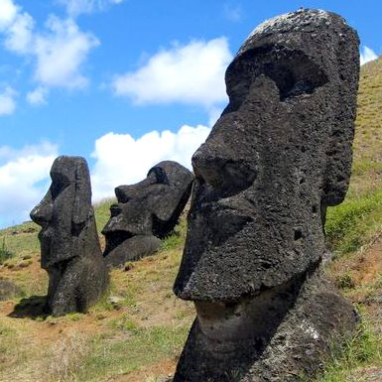
Journal 2-4: Mystery of Easter Island
Human population ecology example
Limiting factors?
Cultural Influence?
Larger Lessons?

