Slide 1
Case Studies
Biology I Honor – Quarter 4

Slide 2
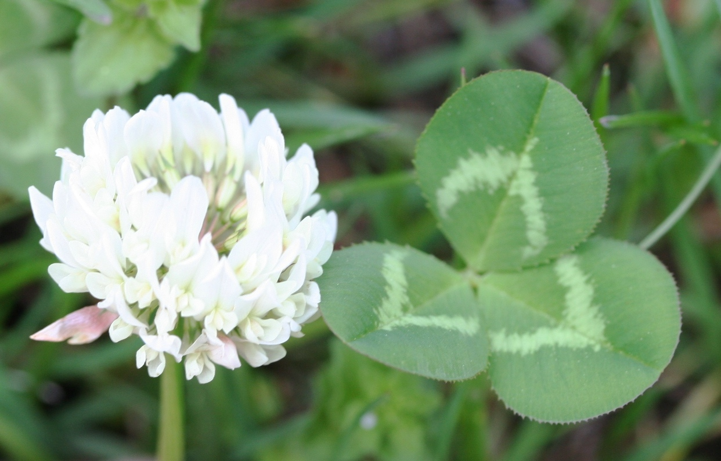
Case Study Assignment
2 cases – 25 pts. each
”Clover” case – Investigation of evolution by natural selection.
Ecology case study of your choice
About two weeks to complete

Slide 3
Case Study Assignment
Requirements…
Do NOT write on the packets, turn in with your completed case
Fully answer each section of the case
Type your work.
Full sentences.
Format your work to match the case study
Tip…
Start right away, it is a lot of work to do in one night

